Slide 1
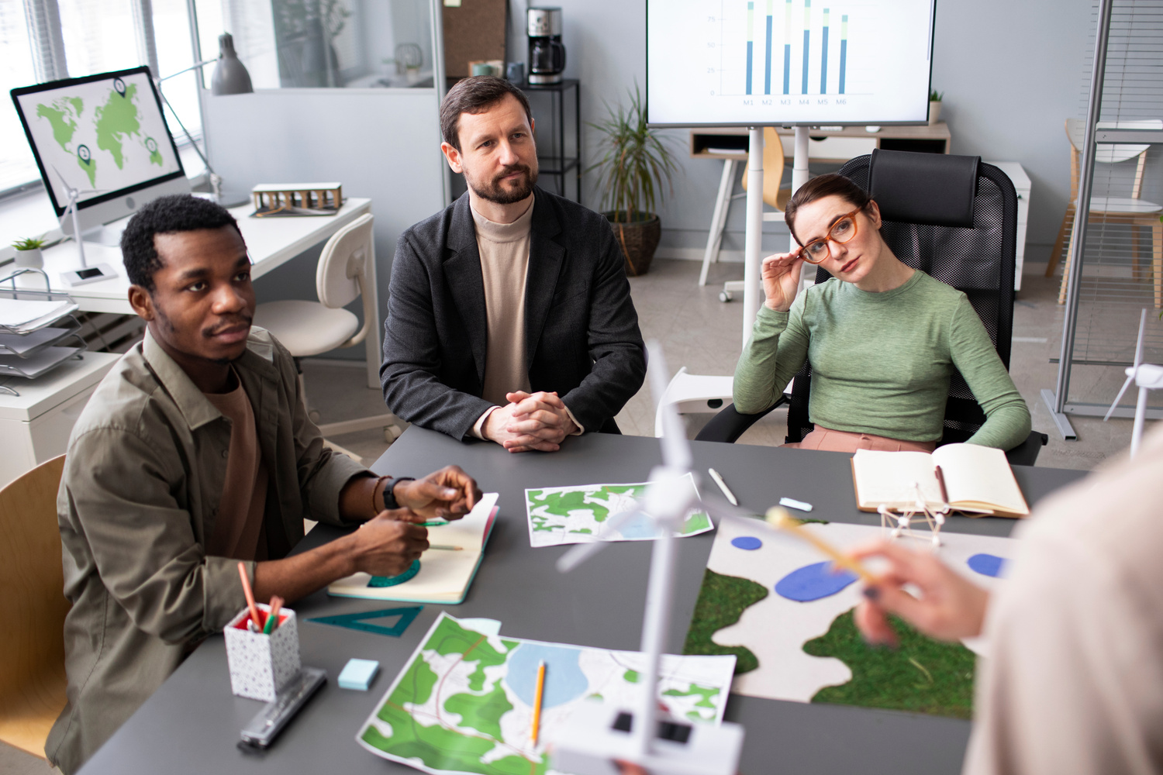
CSR Programs Seattle
Make a lasting impact with CSR programs in Seattle, creating meaningful corporate initiatives that inspire your team, support the community, & boost your brand.

Slide 2
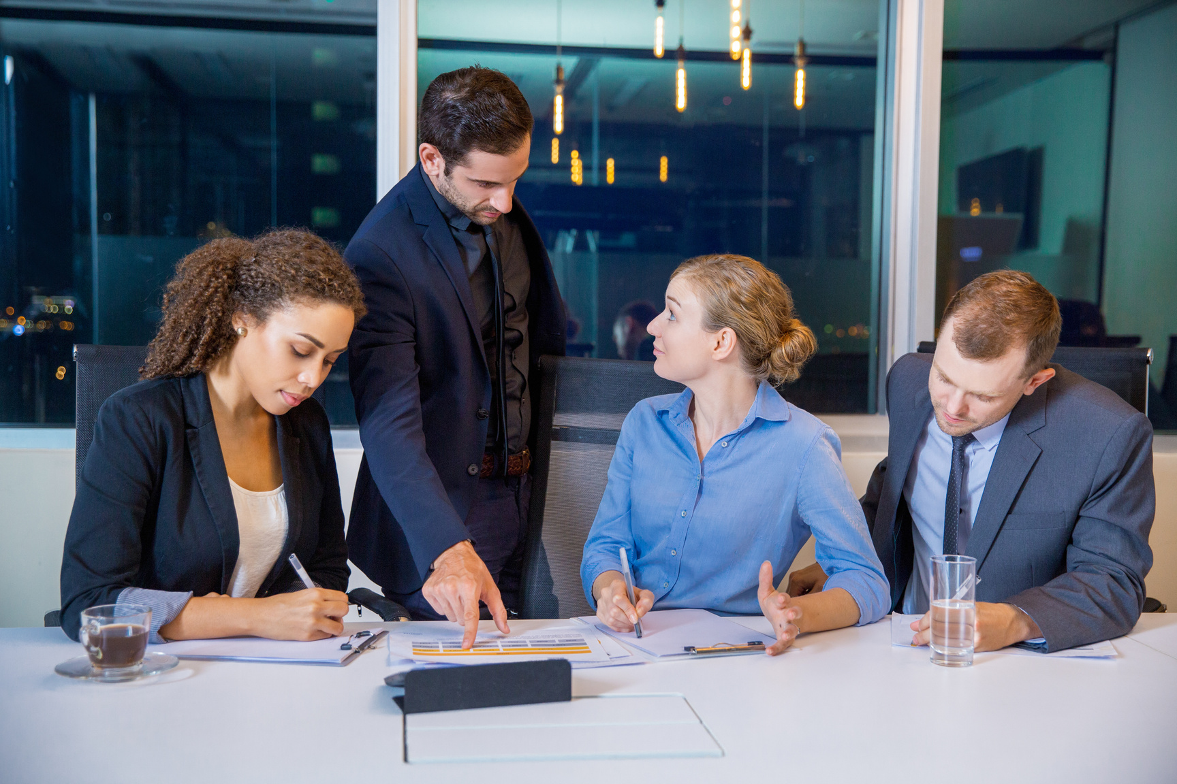
Meeting Planning Seattle
Experience perfect gatherings with meeting planning in Seattle, which provides adept coordination, seamless execution, & an expert touch for corporate events.

Slide 3
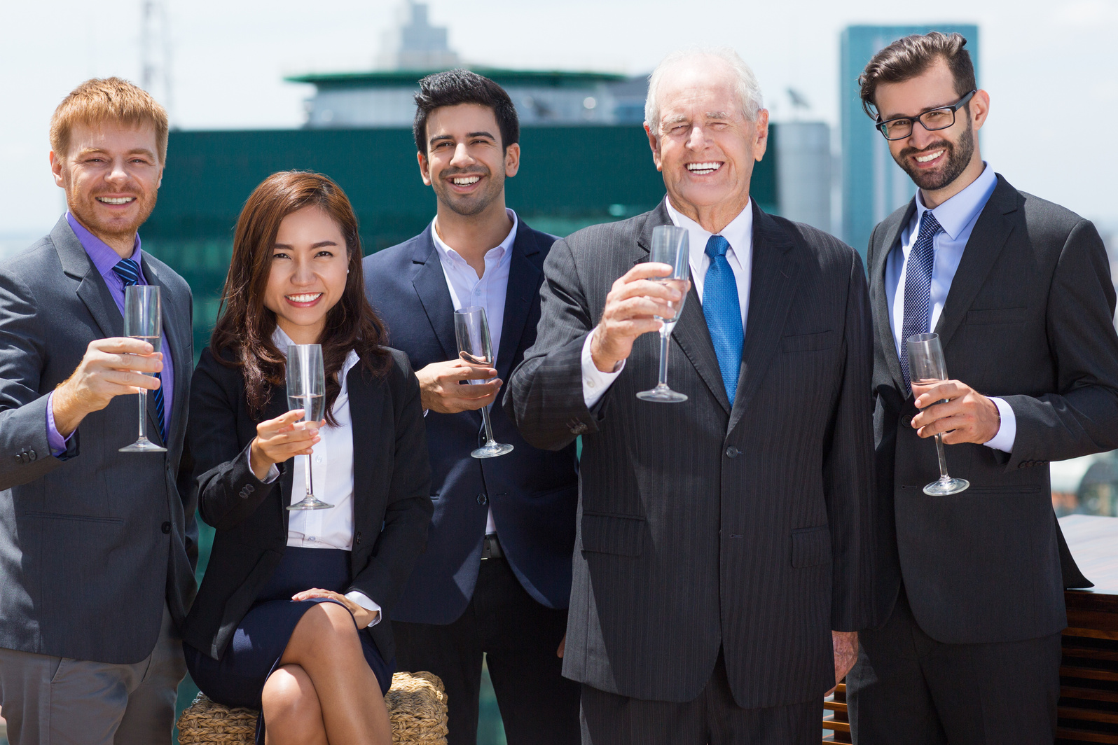
Corporate Event Seattle
Host an exceptional corporate event in Seattle that blends creativity, professionalism, and excitement, leaving a lasting impression on your team and guests.

Slide 4

About Us
Event Experience is a Seattle-based event production agency with a working studio and logistical and creative planning teams. Let us make your event seamless and successful!
Address: 34303 Pacific Hwy S, Federal Way, WA 98003, United States
Website:
https://eventexperience.com

