Slide 1
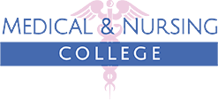
Medical & Nursing College

Slide 2

Medical Assistant Course / Best Nursing Program
With a specialized learning environment, Medical and Nursing College offers a comprehensive Medical Assistant Course. They are dedicated to providing both foundational theoretical knowledge through modern classroom instruction and critical practical skills gained from hands-on training in state-of-the-art medical laboratories, which ensures a deep understanding of each topic. With an accessible fee structure, this course is an ideal pathway to empower students to achieve their professional aspirations. If you are interested in this field, confirm your online admission today.
Finding the ideal college with excellent educational resources can be a real challenge, but luckily, your search can end right in Garden Grove! Because Medical and Nursing College has earned the trust of many students through its commitment to quality care and an exceptional approach to medical and nursing education. This institute is dedicated to preparing every student through its Best Nursing Program and advanced teaching method, which helps them to successfully transform their academic journey into a thriving professional career. For further details, tap on the link!

Slide 3
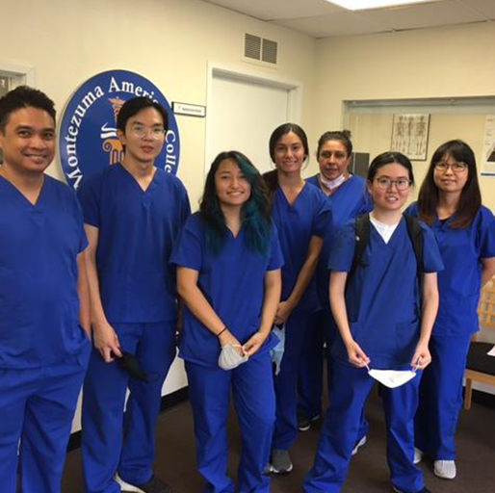
Certified Nursing Assistant Programs / Certified Nurse Assistant Program
For healthcare profession, Certified Nursing Assistant Programs at Medical and Nursing College are available. They are dedicated to providing invaluable real patient care experiences and offering direct mentorship from seasoned healthcare professionals. Here, aspiring students will discover a supportive learning environment, and get the benefit from hands-on training within modern education facilities, and gain access to exciting career opportunities through its robust connections with top hospitals. To enhance your healthcare skills, explore the admission process by visiting the website today.
Looking for the best educational place to fulfill your healthcare career? The Certified Nurse Assistant Program at Medical and Nursing College in Garden Grove is here to equip you with the practical skills needed to make a real impact on patients' recovery and well-being. With their excellent learning environment and experienced faculity you'll gain hands-on proficiency in vital areas like CPR, infection control, taking vital signs, and range of motion exercises, which empower you to confidently assist patients. For further details, click below on the link.

Slide 4

Classes for Certified Nursing Assistant
/ Colleges with A Good Nursing Program
Ready to step into the medical field and make a real difference for patients? Medical and Nursing College offers advance Classes for Certified Nursing Assistant skills. Through their strong partnership with the Department of Public Health, you'll gain in-depth knowledge and hands-on training that will prepare you to confidently apply your learning in real-world patient care scenarios. These essential classes cover crucial topics like CPR, effective infection reduction methods, and mastering vital sign checks, including heart rate, pulse, temperature, and blood pressure, all fundamental skills for providing excellent patient care, especially in critical situations. For more information about these classes, follow the website.
Are you struggling to find the top-notch Colleges with A Good Nursing Program that truly prepares you for a healthcare career? Worry not because the Medical and Nursing College provides exactly what ambitious students expect from a recognized institution. Here, dedicated instructors are genuinely invested in their knowledge in developing your practical skills by offering immersive training in modern medical labs. This hands-on approach builds confidence and deepens your understanding, ensuring you're ready for real-world challenges. To learn about the registration process, explore their website now!

Slide 5

Certified Nurse Assistant Classes / Classes for Nurse Assistant
Join advanced Certified Nurse Assistant Classes at Medical and Nursing College, which offers comprehensive programs designed to prepare students with the skills and confidence needed for a successful healthcare career. This institute provides a unique blend of practical, hands-on experience and engaging classroom instruction, all delivered by professional teachers who are fully focused on developing students' essential abilities using advanced medical teaching methods and modern strategies. After successfully completing your education here, you'll earn a crucial certification that is absolutely necessary to perform your responsibilities competently in any hospital or urgent care center. For more details, tap on the link.
Unlock a rewarding future in healthcare by enrolling in the Classes for Nurse Assistant education at the Medical and Nursing College! Their comprehensive programs offer a direct pathway into one of the industry's most stable and fulfilling career fields, equipping you with essential skills in patient care, medical terminology, and clinical procedures. You'll gain valuable hands-on experience through supervised practicum hours, ensuring you're fully prepared to make meaningful contributions to your community. It’s modern teaching methods, this college is a popular choice for aspiring healthcare professionals looking to build a secure career. To learn more, go to the website!

Slide 6
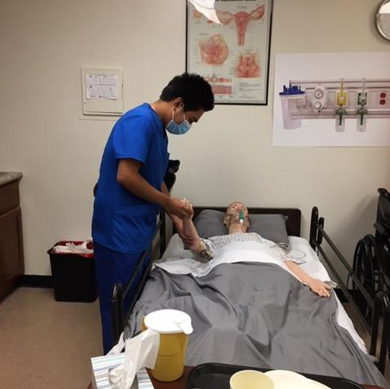
Medical Assistant Programs / Certified Medical Assistant Courses
With the Medical Assistant Programs at Medical and Nursing College, you can take the essential first step toward a truly rewarding career. Their comprehensive education is expertly designed to prepare you for pivotal entry-level positions within reputable hospitals and clinics, and equip you with invaluable hands-on experience. You'll master critical skills such as obtaining vital signs, performing phlebotomy, understanding pharmacology, conducting EKGs, and assisting healthcare providers proficiently. Beyond technical expertise, you will also cultivate the profound medical knowledge needed to effectively support patients, even through their most critical situations. Interested students can apply for registration on the website and get a high level of medical education!
If you're interested in the Certified Medical Assistant Courses from a recognized college, then checking out Medical and Nursing College could be a really smart decision for your future. They're all about giving you both the book smarts and plenty of hands-on training, which really helps build your confidence when you're working with real patients. These courses cover essential medical support skills, like basic anatomy and physiology, anthropometric measurements, and vital signs, all that you'll need to treat patients effectively in hospitals or urgent care centers. To learn more, follow the link!

Slide 7

Affordable Nursing Schools / CNA Trainee Program
Dreaming of a nursing career but worried about the cost? The Medical and Nursing College is here to make that dream a reality with its top-notch nursing education and affordable fee structure. That's why this college proudly stands among the most Affordable Nursing Schools, dedicated to empowering your future without the burden of overwhelming student debt. Their experienced faculty, unparalleled hands-on clinical experiences, and truly student-focused approach don't just teach; they meticulously prepare you for a thriving career in healthcare. For admission, contact (949) 350-4506 now.
If you're eager to pursue your CNA Trainee Program at a reputable institution, your search for quality education ends here! because Medical and Nursing College offers an exceptional program designed to equip you with in-depth knowledge and hands-on skills in every subject, ensuring you become a proficient CNA ready to assist patients with the latest techniques and compassionate care. Their dedicated instructors truly believe in fostering high-quality education and student capabilities, which is why they're always there to clarify doubts and guide them every step of the way. To learn about the admission process, follow the website.

Slide 8
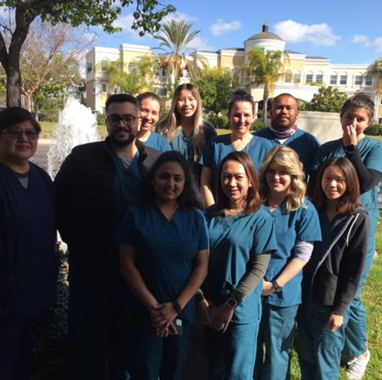
CNA Training / CNA Practice Exam
Unlock a world of opportunity and compassionate impact with the Medical and Nursing College's comprehensive CNA Training, your ideal launchpad into the dynamic medical field. Their meticulous education cultivates indispensable skills, from mastering life-saving CPR and implementing rigorous infection reduction methods to executing precise vital sign assessments. These critical competencies are not merely taught; they are ingrained, forming the bedrock for delivering truly exceptional care, especially in the most demanding scenarios. For more information related to their nursing and medical education, tap on the link.
Getting ready for a healthcare career means you need top-notch preparation and confidence in your skills. That's why the Medical and Nursing College steps in, which offers an invaluable education. Through their experienced medical teaching staff, they don't just cover the books; they expertly reinforce theoretical knowledge with practical, hands-on training, building a robust foundation that transforms many students' careers. Their ultimate priority is ensuring every student sharpens their medical and technical skills, that empowering them to confidently pass the CNA Practice Exam and launch their professional journey. So why wait? Complete the registration for your chosen medical or nursing course right on the website!

Slide 9

Certified Nurse Aid Classes / CNA Nursing Classes
Interested in Certified Nurse Aid Classes to kickstart your healthcare career? Forget the struggle of finding a reputable college, because the Medical and Nursing College provides exactly what you need. They offer comprehensive programs, including CNA, with a perfect blend of practical, hands-on training and engaging classroom instruction designed to truly build your confidence and competence. They are also dedicated to providing the best educational resources for enhancing healthcare skills so that you can turn your passion into a profession. To learn more, go to the website.
If you're passionate about helping others and ready to dive into a fulfilling medical career, the CNA Nursing Classes of Medical and Nursing College are your perfect starting point. Here, you'll gain essential hands-on training under the guidance of experienced, professional instructors who are genuinely invested in your success, by enhancing crucial clinical skills like safely turning and moving patients, assisting with feeding and accurately documenting intake, and precisely measuring vital signs such as blood pressure, heart rate, and body temperature. To explore more about this college and its provided programs, follow the link.

Slide 10
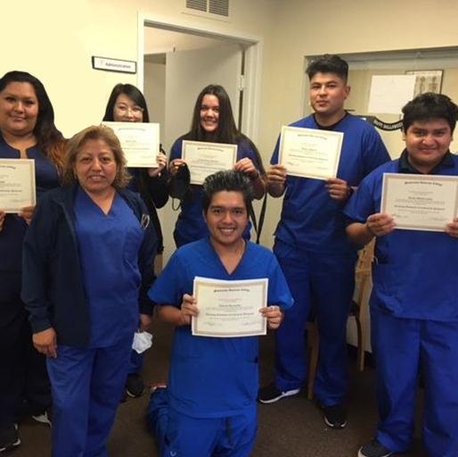
CNA Certification Course / CNA Courses
Elevate your essential medical skills with the CNA Certification Course offered by Medical and Nursing College. This comprehensive program, developed through a strategic partnership with the national healthcare career association, delivers not only foundational knowledge but also nationally recognized standards of clinical excellence. Students will gain hands-on training in critical areas such as life-saving CPR techniques, infection control protocols, and therapeutic exercises designed to promote faster patient recovery and long-term well-being, which prepares them to confidently provide patient care in diverse real-world healthcare settings. For details on the registration process, please click on the website.
Medical and Nursing College offers affordable CNA Courses, meticulously designed to equip trainees with the essential skills required to bridge the critical gap between patients and nursing assistants in both long-term care facilities and reputable hospitals. Beyond preparing students for national or state certification, their curriculum empowers the students to confidently handle patients in emergencies and deliver genuine treatment that supports faster recovery. Furthermore, dedicated teaching staff also focus on developing crucial soft skills, such as communication and diversity, which are vital for effective interaction with patients and their families. For further information, follow the website.

Slide 11
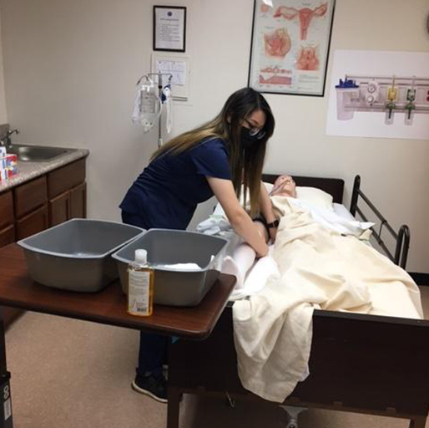
Home Health Aide Certification / Home Health Aide Training
Looking to earn your Home Health Aide Certification? The Medical and Nursing College offers this credential after you've gained a solid foundation through its medical or nursing courses. A great perk is that all their programs are offered at reasonable fees, which makes their quality education accessible for many students without the burden of heavy charges. The college also integrates practical training with theoretical instructions, focusing on essential real-world application to rigorously prepare graduates, ensuring you'll be fully equipped to deliver high-quality care upon program completion. For more details, visit their website!
Medical and Nursing College now offers Home Health Aide Training, alongside other distinguished nursing and medical programs, meticulously designed to prepare students for successful careers in the healthcare sector. Within a nurturing educational environment, aspiring professionals benefit from advanced learning delivered by a dedicated team of highly qualified faculty, that fostering their full potential. Their paramount focus is on trainees gaining valuable practical experience through direct patient interaction under the careful supervision of senior medical professionals. Want to learn more about this college? Follow the provided link.

Slide 12

HHA Certification
To a fulfilling career where you bring comfort and care directly to those who need it most, starting right here at the Medical and Nursing College, proudly approved by the Department of Public Health for trust and quality recognized nationwide. Their highly sought-after HHA Certification and other medical and nursing programs are your first step, which will expertly equip you with the essential skills to become a truly compassionate and competent healthcare professional. Here you'll gain crucial hands-on experience and vital knowledge on topics like basic patient care, infection control, medication assistance, and effective communication, which will help you to deliver excellent care and build strong trust with patients and their families. For further details, go to the website!

Slide 13

medicalnursecollege.com

