Slide 1
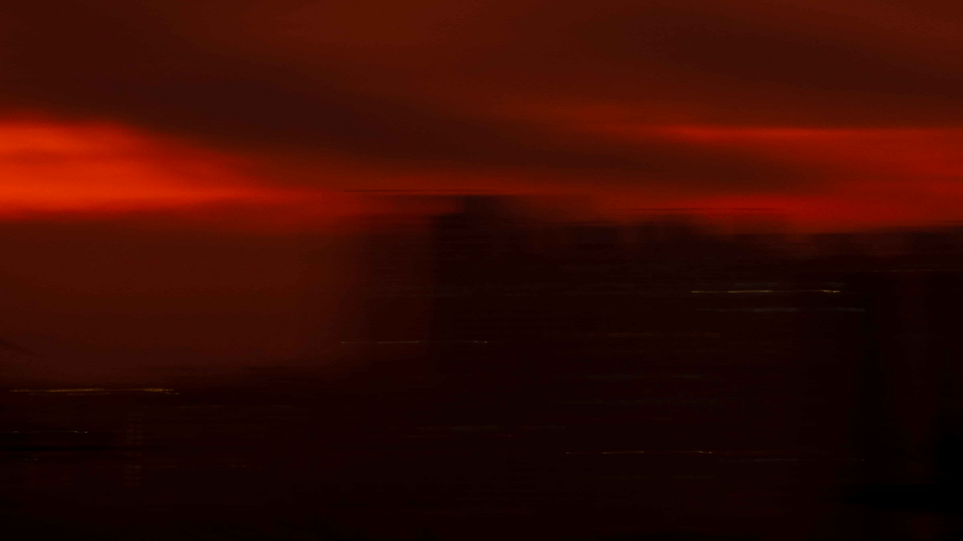
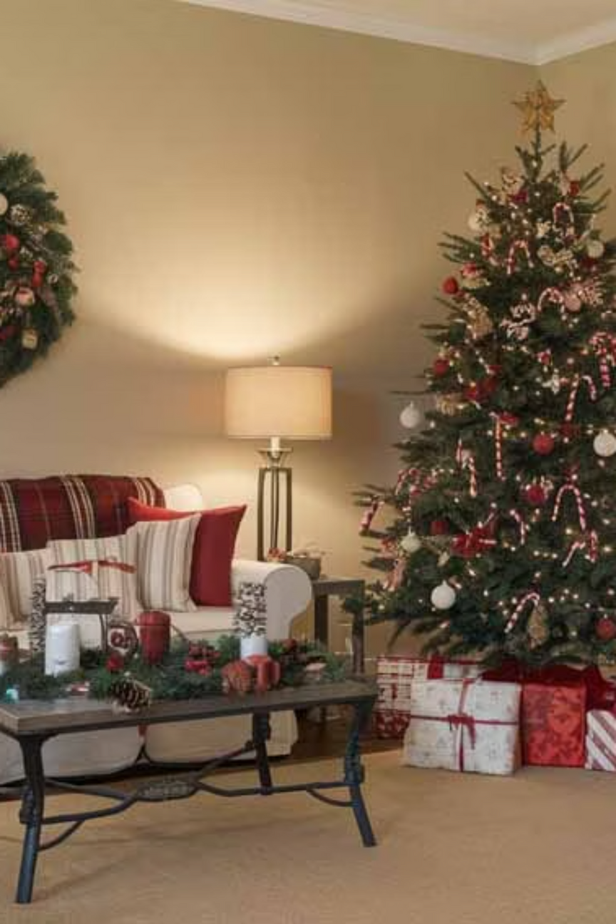

Christmas Decoration Ideas for 2025: Warmth, Nostalgia & Nature
Discover the season's most enchanting trends that blend timeless tradition with fresh, contemporary style. This year's celebrations embrace comfort, nature, and the art of storytelling through thoughtful design.
Notes:
1

Slide 2



The Heart of 2025 Holiday Decor
Comfort & Intimacy
Storytelling Focus
Warm Lighting
Create spaces that feel like warm embraces, where every corner invites connection and cherished moments with loved ones.
Each decoration tells a tale—heirloom ornaments, handcrafted pieces, and meaningful touches that celebrate your family's unique journey.
Fairy lights dance across mantels, dimmable candles flicker gently, and soft glows transform ordinary rooms into magical sanctuaries.
This season celebrates a beautiful return to classic, timeless motifs reimagined with fresh perspectives—honoring tradition while embracing modern sensibilities.
Notes:
2

Slide 3
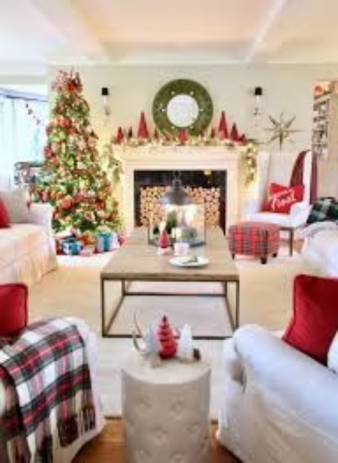
Ralph Lauren Christmas: Classic Heritage Revival
The Signature Palette
Rich hunter greens evoke evergreen forests, deep reds capture holiday warmth, and aged brass accents add distinguished elegance reminiscent of grand estates and timeless luxury.
Layered Sophistication
Master the art of layering by pairing traditional tartan patterns with gleaming crystal glassware and burnished brass details, a Christmas Decoration Idea that adds depth and visual interest while maintaining refined elegance.
Rustic Americana Meets Elegance
Vintage Treasures
Cozy yet sophisticated aesthetic that balances rugged charm with polished refinement
Ralph Lauren pieces become coveted seasonal heirlooms, passed down through generations
Notes:
3

Slide 4
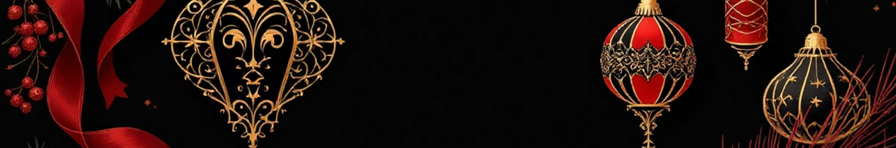



Vintage Elegance & Romantic Domesticity
Art Deco Inspiration
Cool Winter Palette
Handmade Touches
Draw from old-world glamour with geometric patterns, luxurious velvet ribbons, and shimmering tinsel that catches the light beautifully.
Embrace icy sophistication with silver, soft blue, and patinaed metallics that evoke frost-kissed mornings and elegant winter wonderlands.
Craft memories with dried citrus garlands, nostalgic popcorn strings, and charming gingerbread toppers that fill your home with warmth.
Creating spaces that feel lived-in, loved, and story-filled—where every ornament whispers tales of Christmases past and dreams of celebrations yet to come.
Notes:
4

Slide 5
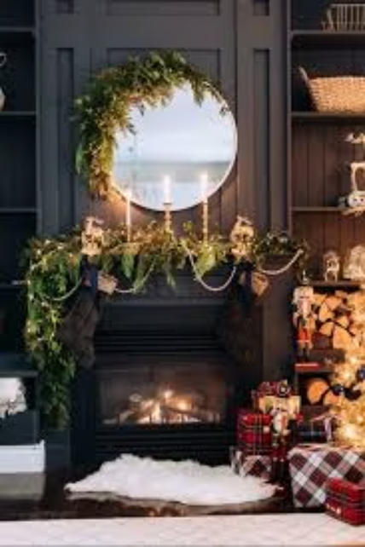
Nature-Inspired & Sustainable Decorations
Woodland Wonderland
Bring the forest indoors with pinecones scattered artfully, whimsical mushroom accents, and silhouettes of majestic trees that celebrate nature's quiet beauty.
Natural Materials
Wood beads strung with care, woven textiles in earth tones, and handcrafted pottery pieces add authentic, organic texture to your holiday displays.
Fresh Greenery
Eco-Friendly Choices
Lush garlands and oversized statement bows create festive cheer while honoring the season's natural abundance.
Repurposed décor and sustainable accents allow you to celebrate mindfully while reducing environmental impact.
Notes:
5

Slide 6
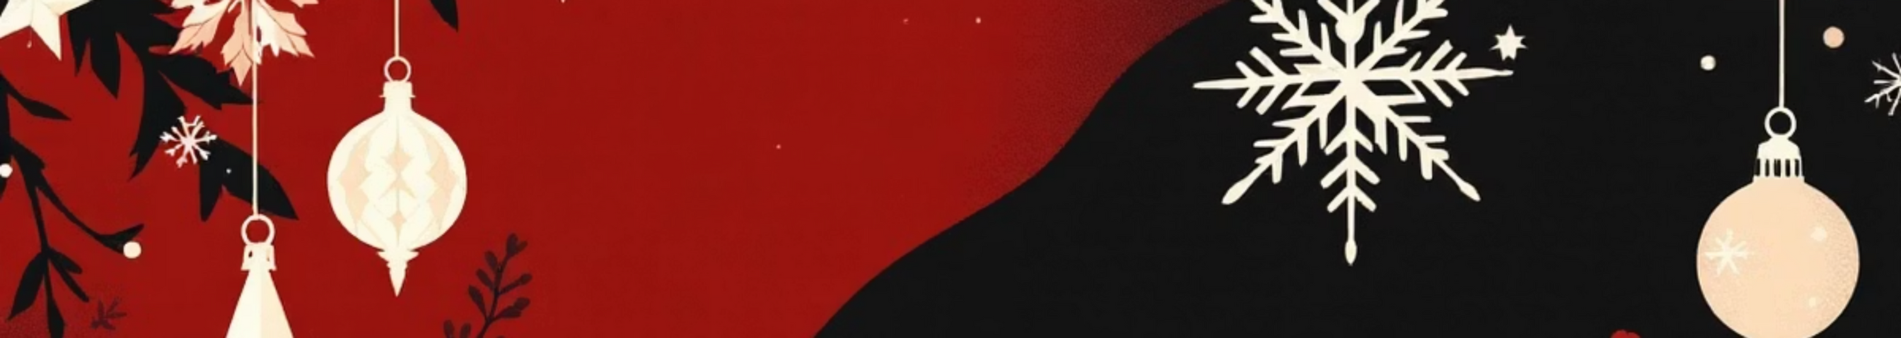
Cozy & Playful Folk-Scandi Style
Minimalist Foundation
Handcrafted Details
Polished Yet Homey
Start with clean white walls that provide the perfect backdrop for simple, cherished hand-me-down decorations passed through generations.
Delicate paper stars float overhead, wood bead garlands drape gracefully, and hand-painted ornaments showcase artisanal craftsmanship.
Swedish handicraft traditions inspire a vibe that's both refined and welcoming—perfect for those who value intentional, meaningful design.
This aesthetic celebrates the beauty of simplicity, where less becomes more, and every carefully chosen piece holds significance and charm.
Notes:
6

Slide 7
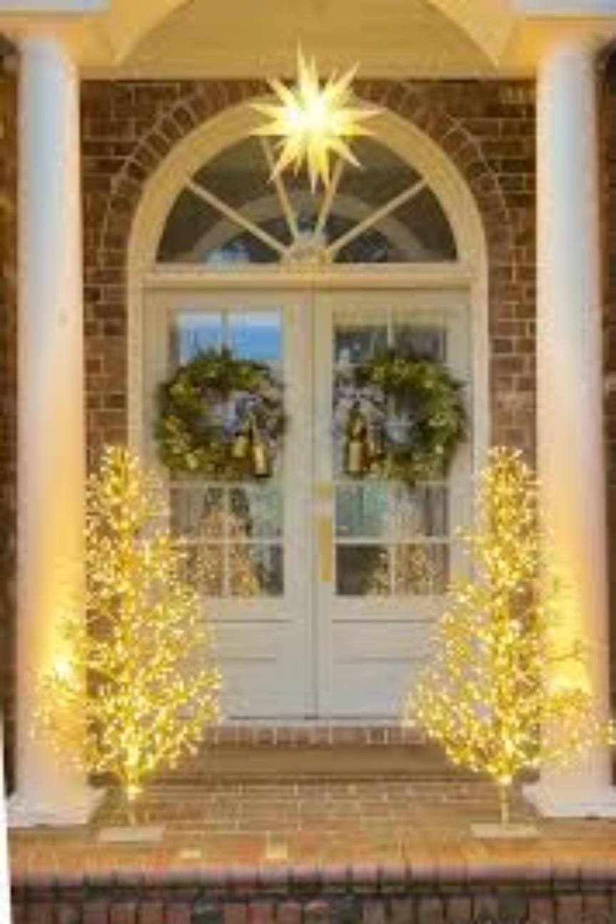
DIY & Easy Decorating Ideas
01
Upgrade Faux Wreaths
Transform basic wreaths by adding luxurious ribbons, jingle bells, and ornaments for instant personality and festive appeal.
02
Choose Quality Faux Trees
Nordic-style pre-lit trees provide sturdy branches that hold heavier ornaments beautifully while saving time on decorating.
03
Layer Cozy Textiles
Mix jewel-toned velvet pillows with plush faux fur throws to create inviting, touchable layers that beg for snuggling.
04
Personalize with Traditions
Incorporate family ornament traditions and personalized touches that make your celebration uniquely yours and filled with meaning.
Notes:
7

Slide 8
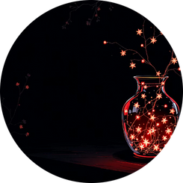
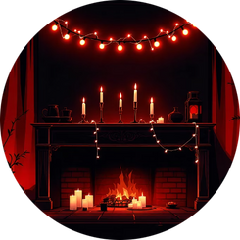
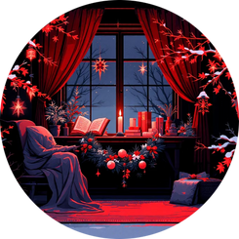
Lighting & Ambiance: The Magic of Glow
Create Wonder Through Light
Layered Luminosity
Soft Illumination
Intimate Spaces
Combine dimmable candles with warm white string lights to create adjustable ambiance perfect for any mood.
Design cozy nooks with flickering candlelight and amber hues that invite quiet reflection and peaceful moments.
Tuck fairy lights inside glass vases and weave them through greenery for ethereal, multi-dimensional glow.
Pro Tip: Lighting is the secret ingredient that transforms ordinary decorations into magical experiences, evoking holiday wonder and heartfelt warmth in every corner of your home.
Notes:
8

Slide 9
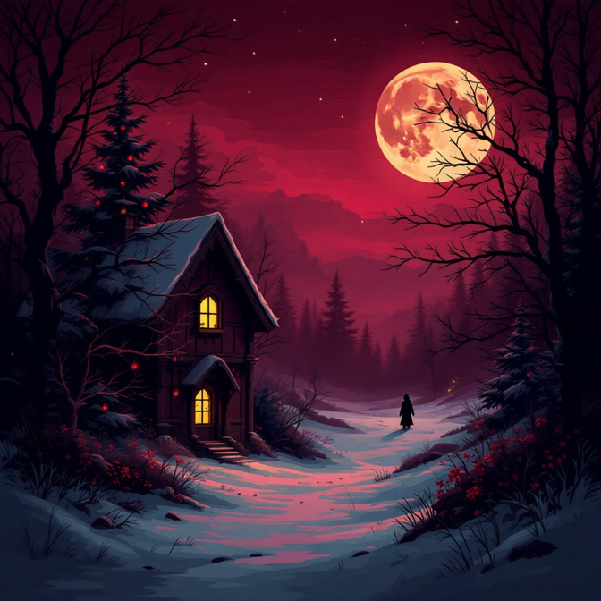
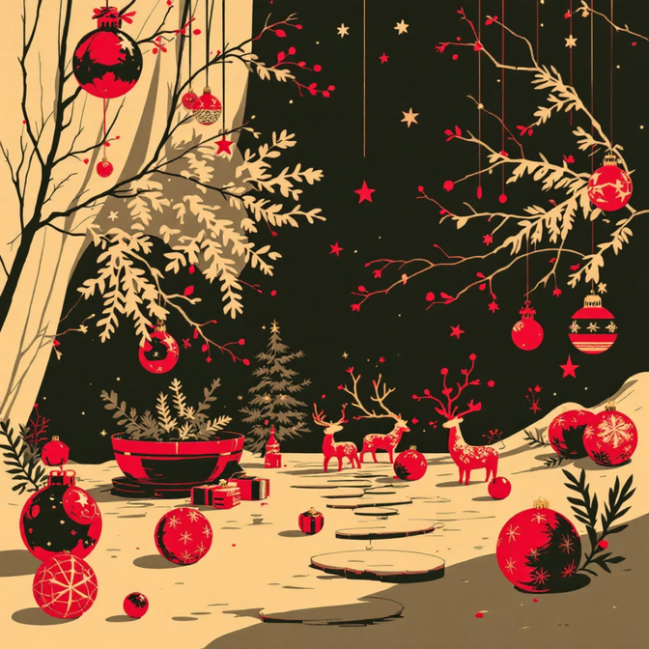
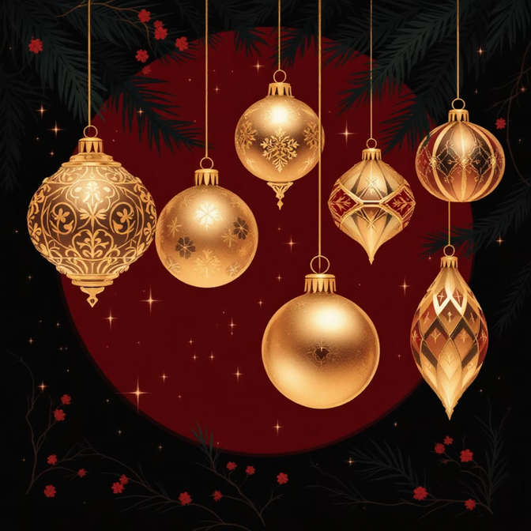
Trending Color Palettes for 2025
Classic with a Twist
Jewel Tone Richness
Traditional reds and greens reimagined with modern proportions, unexpected patterns, and contemporary styling techniques.
Deep burgundy exudes luxury, emerald brings natural vibrancy, and sapphire adds regal sophistication to your décor.
Warm Neutrals
Metallic Accents
Versatile ochres and creamy tones provide grounding, allowing bolder colors to shine while maintaining cozy elegance.
Aged brass offers vintage charm, silver provides cool sophistication, and rose gold adds romantic, contemporary flair.
Notes:
9

Slide 10
Make Your 2025 Christmas Magical
Blend Tradition with Personal Stories
Embrace Nature and Sustainability
Honor time-tested customs while weaving in your family's unique narrative through handmade details and cherished heirlooms that speak to your journey.
Choose meaningful décor that respects the earth—natural materials, repurposed treasures, and eco-conscious choices that feel good for the soul and planet.
Layer Textures, Colors, and Light
Celebrate with Joy and Timeless Style
Build depth and interest by combining varied textures, harmonious color palettes, and thoughtful lighting that creates warmth, nostalgia, and enchantment.
Above all, let your decorations reflect the true spirit of the season—joy, coziness, connection, and love that transcends trends and touches hearts.
May your 2025 Christmas be filled with warmth, wonder, and memories that last a lifetime.
Notes:
10

