Slide 1



Versatile Rental Services
Unlock top‑notch versatile rental services tailored just for you, delivering quality, convenience, and simplicity to handle any task with ease & peace of mind.

Slide 2
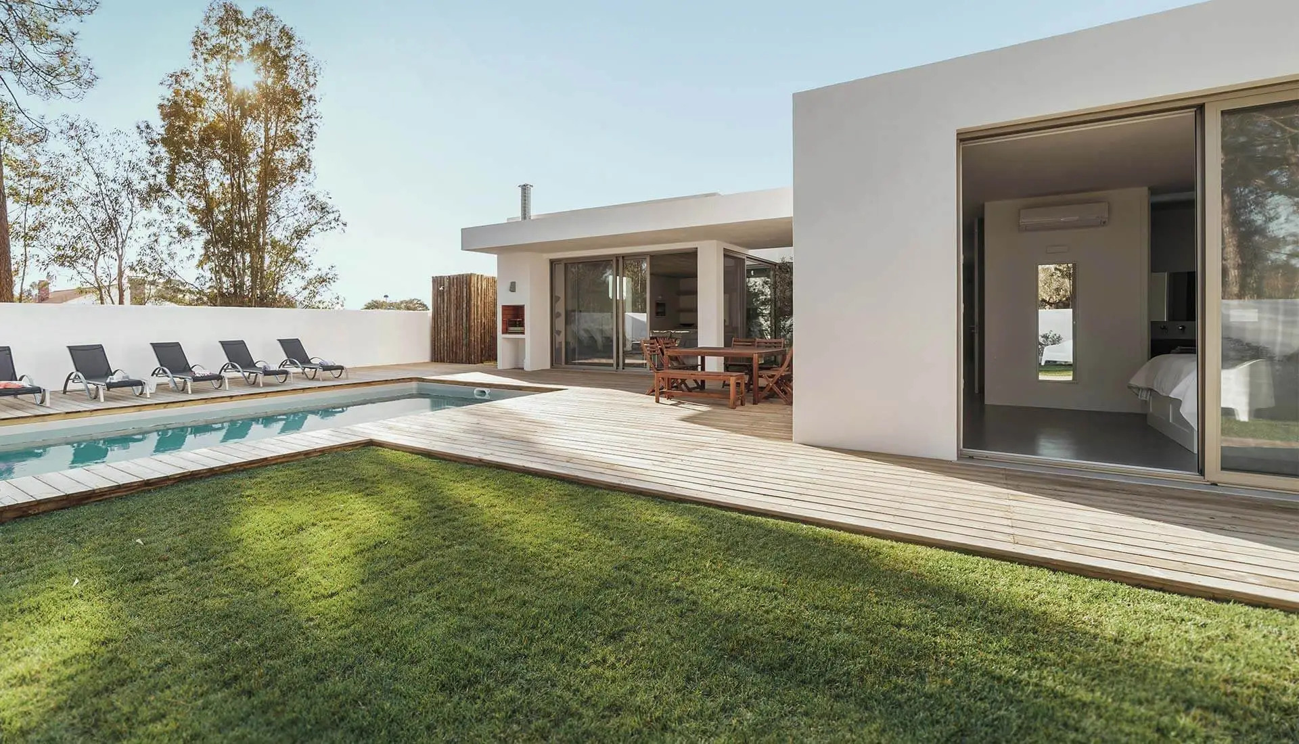
Explore our premium short term rentals designed for comfort and ease, with fully furnished homes, smooth check-ins, and a cozy vibe for every type of traveler.
Premium Short Term Rentals

Slide 3
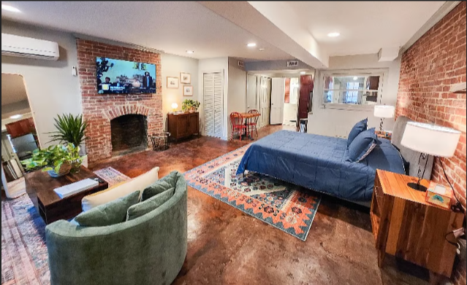
Premium Short Term Rentals
Explore our premium short term rentals designed for comfort and ease, with fully furnished homes, smooth check-ins, and a cozy vibe for every type of traveler.
https://app.mediafire.com/
https://app.mediafire.com/

Slide 4




Contact Us
At ST Rentals, we offer reliable and flexible short-term housing solutions tailored to your needs. With quality properties and dedicated service, we make every stay feel like home.
United States
https://st-rentals.com/

