Slide 1

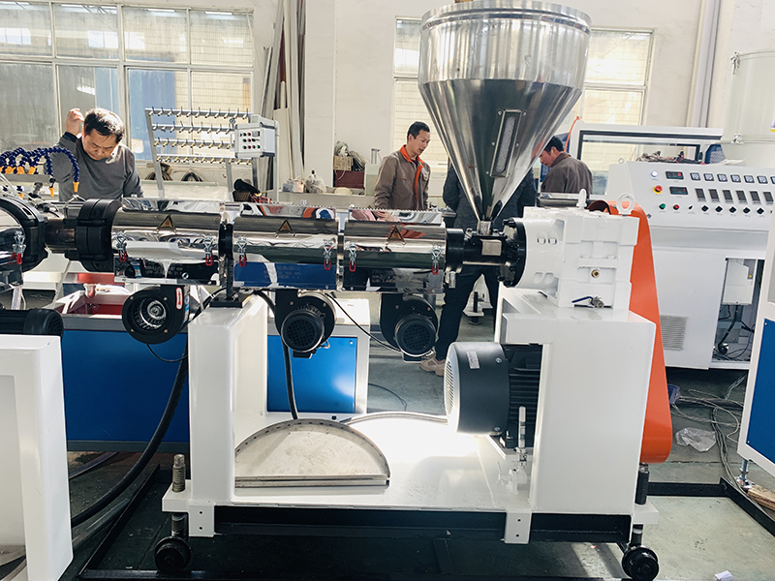

Data Center Cooling System
Reliable Cooling for Critical IT Infrastructure
  Continuous cooling for servers and networking equipment
  Prevents overheating and thermal hotspots
  Supports 24/7 data center operations
  Improves equipment reliability and performance
  Designed for efficiency, scalability and redundancy
Prematech Cooling — Industrial & Precision Cooling Solutions
Notes:
1

Slide 2






What is a Data Center Cooling System?
A Data Center Cooling System removes the heat generated by servers, storage systems, networking equipment and electrical infrastructure.
Key Functions:
Temperature control
Humidity management
Heat removal
Airflow management
Thermal hotspot prevention
Continuous environmental monitoring
Notes:
2

Slide 3






Types of Data Center Cooling
CRAC Systems
CRAH Systems
  Direct-expansion cooling
  Suitable for smaller and medium facilities
  Chilled-water based cooling
  Suitable for larger data centers
Chilled Water Systems
Liquid Cooling
  Centralized cooling
  Efficient for high-capacity applications
  Direct-to-chip cooling
  Rear-door heat exchangers
  Suitable for AI and high-density computing
Notes:
3

Slide 4

Major Components
A complete Data Center Cooling System may include:
  CRAC / CRAH units
  Chillers
  Cooling towers
  Pumps
  Dry coolers
  Air handling systems
  Temperature & humidity sensors
  BMS / DCIM controls
  Leak detection systems
Proper integration of these components ensures stable and efficient cooling.
Notes:
4

Slide 5

Airflow Management
Effective airflow is essential for maintaining consistent server temperatures.
Important Practices:
Hot aisle / cold aisle arrangement
Hot aisle or cold aisle containment
Proper supply-air distribution
Reduced bypass airflow
Prevention of hot-air recirculation
Continuous temperature monitoring
Result: Better cooling efficiency and fewer thermal hotspots.
Notes:
5

Slide 6
Energy Efficiency & Reliability
A modern Data Center Cooling System should provide both efficiency and reliability.
Efficiency Features
Reliability Features
  Variable-speed fans and pumps
  Intelligent temperature controls
  Free cooling opportunities
  Efficient heat rejection
  Load-based cooling
  N+1 redundancy
  Backup cooling equipment
  Continuous monitoring
  Preventive maintenance
  Alarm and fault detection
Notes:
6

Slide 7
Cooling for AI & High-Density Data Centers
AI, GPU and HPC workloads generate significantly higher heat densities.
Advanced Cooling Solutions:
Direct-to-chip liquid cooling
Rear-door heat exchangers
Coolant Distribution Units
Immersion cooling
Hybrid air + liquid cooling
A future-ready Data Center Cooling System should allow scalability and support increasing rack densities.
Notes:
7

Slide 8
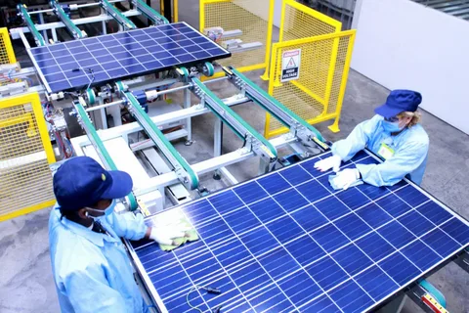
Prematech Cooling
Your Partner for Data Center Cooling Solutions
Prematech Cooling provides engineered cooling solutions for demanding industrial and critical applications.
Our Approach
Why Prematech Cooling?
  Application-based cooling design
  Capacity planning
  Energy-efficient solutions
  Reliable system configuration
  Scalable cooling infrastructure
  Monitoring and control integration
Reliable • Efficient • Scalable • Application-Focused
Looking for a Data Center Cooling System?
Visit: https://prematechcooling.in/
Prematech Cooling — Industrial & Precision Cooling Solutions
Notes:
8

