Slide 1
Silver Tungstate
Visit us to order silver tungstate for high-tech research and industrial use. Viridis Materials offers top-quality, government-grade chemicals worldwide.
Notes:
Links:
https://www.pexels.com/photo/photo-of-people-looking-on-laptop-3182812/

Slide 2
Copper Metal
Buy high-purity copper metal from Viridis Materials for research, industrial applications, and advanced projects with reliable quality and global delivery.
Notes:
Links:
https://www.pexels.com/photo/photo-of-people-looking-on-laptop-3182812/

Slide 3
Silver Acetate
At Viridis Materials, you can get high-purity silver acetate for laboratory and production needs. We ensure quality, safety & eco-friendly sourcing globally.
Notes:
Links:
https://www.pexels.com/photo/photo-of-people-looking-on-laptop-3182812/

Slide 4
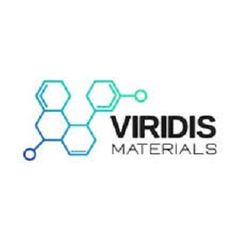
Contact Us
About: Viridis Materials provides high-quality metals, alloys, ceramics, and high-purity compounds for research and industry delivering trusted, eco-conscious materials with global reach and expert service.
Address: 8549 Wilshire Blvd Ste 2037 Beverly Hills, CA 90211
Phone No: +1 (323) 794-0820
Website: https://viridismaterials.com/
Notes:
Links:
https://www.pexels.com/photo/photo-of-people-looking-on-laptop-3182812/

