Slide 1
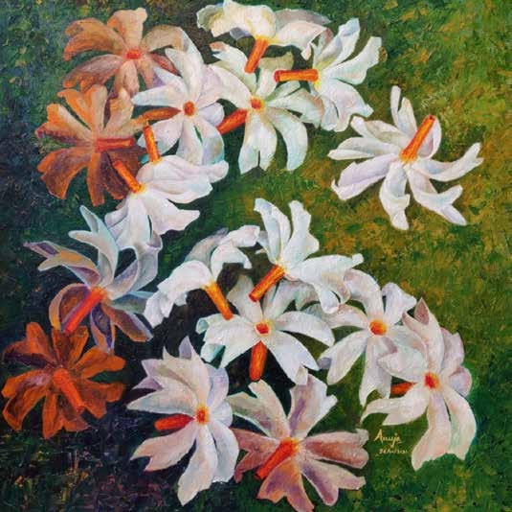
https://www.mojarto.com/artworks/photography

Slide 2
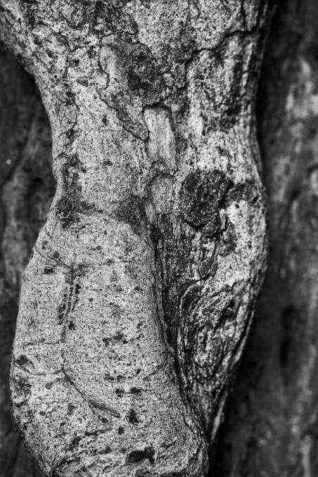
ABOUT US
Mojarto, founded in 2005, has been the largest and most innovative online art platform in the country. We are strong believers in the transformational power of technology and have long been the pioneering art entity in the country; bringing together artists, collectors, dealers, galleries and resellers onto a single powerful online platform. With a state of the art user experience, and a leading edge art portal backed by some amazing analytics and data, we transform the art shopping experience, empower artists, and provide a huge convenience for those who wish to re-sell their art.
https://www.mojarto.com/artworks/photography

Slide 3
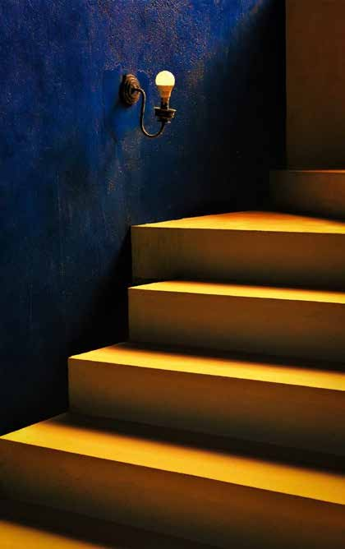
Introduction to Mojarto
India’s leading online art marketplace
Curated collections from emerging and established artists Wide range of artwork: Paintings, sculptures, and wall photography prints
Trusted by art lovers and collectors globally
What Are Wall Photography Prints?
High-resolution photographic artworks printed on premium materials
Perfect for modern interiors – homes, ofﬁces, and galleries Available in various themes: nature, abstract, portraits, architecture, and moreUnique way to personalize and elevate your space
https://www.mojarto.com/artworks/photography

Slide 4
FOLLOW US
https://www.pinterest.com/mojartoofﬁcial/
https://www.facebook.com/Mojarto-191313941210803/
https://www.instagram.com/mojarto_ofﬁcial/ https://twitter.com/Mojarto https://in.linkedin.com/company/mojarto-presented-by-ndtv https://www.youtube.com/channel/UCR4FbHC8JGcz2T1KVHfQzRg/
https://www.mojarto.com/artworks/photography

Slide 5
CONTACT US
No 123, Sterling Rd, Nungambakkam, Chennai, Tamil Nadu 600034
partners@mojarto.com/contactus@mojarto.com
https://www.mojarto.com/artworks/photography

Slide 6
THANK YOU
https://www.mojarto.com/artworks/photography

