Slide 1

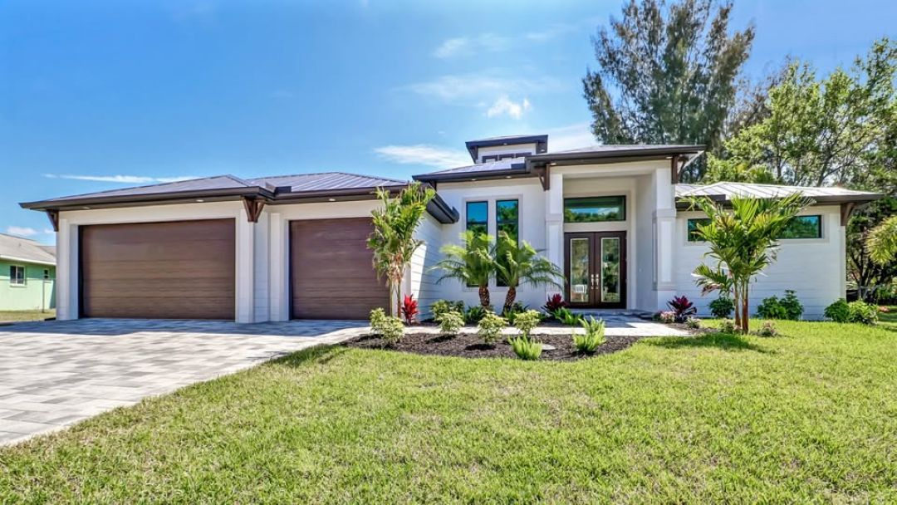
Why Are Home Builders Fort Myers FL, Focusing On Multi-Generational Homes

Slide 2
A multi-generational house provides the benefits of several rooms, individual privacy, and a gradual increase in value all in one place. All generations in a family stay together, maintain their relationship, and at the same time have their own space. A larger home no longer feels like extra space; it feels like smart planning.
Sposen Signature Homes creates homes to satisfy real family needs. Their team understands how Florida families live, grow, and change. They build homes that support long-term comfort and function without wasting space.
Why Multi-Generational Living Continues to Grow
Many families now live together to share costs and care. Rising housing costs drive families to think smarter. Aging parents require support. Young adults can save faster when they stay closer to their families. All these needs can be accomplished with one smart move: a larger home.
There are several reasons families choose multi-generational homes:
Shared daily support.
Lower combined living costs.
Built-in childcare assistance.
Safe aging in place.
Stronger family relationships.

Slide 3
Florida also attracts retirees. A large home allows everyone to stay connected without losing independence.
There are many buyers in Southwest Florida who explore options through the home builders Fort Myers FL. These builders focus their designs on supporting modern family needs. The right builder creates layouts without cutting off connections and still gives privacy to everyone.
Smart Layouts That Protect Privacy
A multi-generational home is one that must balance connection and privacy. Good design separates living spaces while keeping shared areas central. It’s in kitchens and living rooms that families enjoy time together. They still retreat to private bedrooms and suites as needed.
Modern large homes often include:
Dual master bedrooms.
Guest suites with private baths.
In-law quarters with separate entries.
Extra living rooms or bonus rooms.
Sposen Signature Homes designs these floor plans with a purpose: to keep families close without crowding, to give every room a clear function, and to not waste any space.

Slide 4
Many families discuss home builders Fort Myers for the construction of such layouts from the beginning to avoid renovations later.
Financial Benefits of One Larger Home
One well-designed large home often costs less than two smaller homes. Utility bills, taxes, and maintenance costs are divided among the families. Instead of paying twice, they invest once and gain more value.
Multi-generational homes also add value over the long term. Buyers want flexibility in their floor plans. A home that works for multiple life stages appeals to future buyers. That home stays in demand even if the markets change.
Sposen Signature Homes guides families in smart budgeting. Their professionals assist clients in choosing appropriate layouts for their present and future requirements. With experience in constructing long-term homes, families enjoy strong peace of mind.
Many buyers depend on Home Builders Fort Myers FL, who understand the laws regarding land use, zoning, and home design in Southwest Florida. This local knowledge protects both budget and project timelines.

Slide 5
Aging Parents Gain in Safety and Comfort
Aging in place matters to many families. Parents can stay close to family care without giving up dignity or independence. A large home allows seniors to enjoy comfort without isolation.
Features contributing toward safe aging include:
Wide doorways and halls.
Step-free showers.
First-floor bedrooms.
Handrail stairways.
Sposen Signature Homes incorporates these features into home design without making the home feel medical or outdated. Their homes are warm, modern, and easy to live in at any age.
When working with experienced home builders Fort Myers, families are supported through the planning process and avoid expensive changes later.

Slide 6
A Long-Term Decision for Expanding Families
Living together in a multi-generational way reinforces long-term family bonding. Kids become adults, parents and grandparents stay together, and life undergoes changes. The bigger and properly designed house easily transitions with the family and requires fewer changes.
The families that plan ahead avoid costlier moves later. They build a strong foundation rather than hopping from home to home.
Sposen Signature Homes leads this movement in Southwest Florida, building homes that adapt, protect privacy, and support real family life. Their commitment to quality construction, functional design, and personal service gives families confidence in every step.

Slide 7

For More Details Contact Us :
Name: Sposen Signature Homes
Address: 2311 Santa Barbara Blvd, Suite 112, 33991 Cape Coral, Florida, USA
Telephone: 239-244-8886
Email id: hello@sposenhomes.com
Website: https://sposenhomes.com

