Slide 1
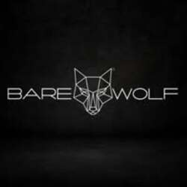
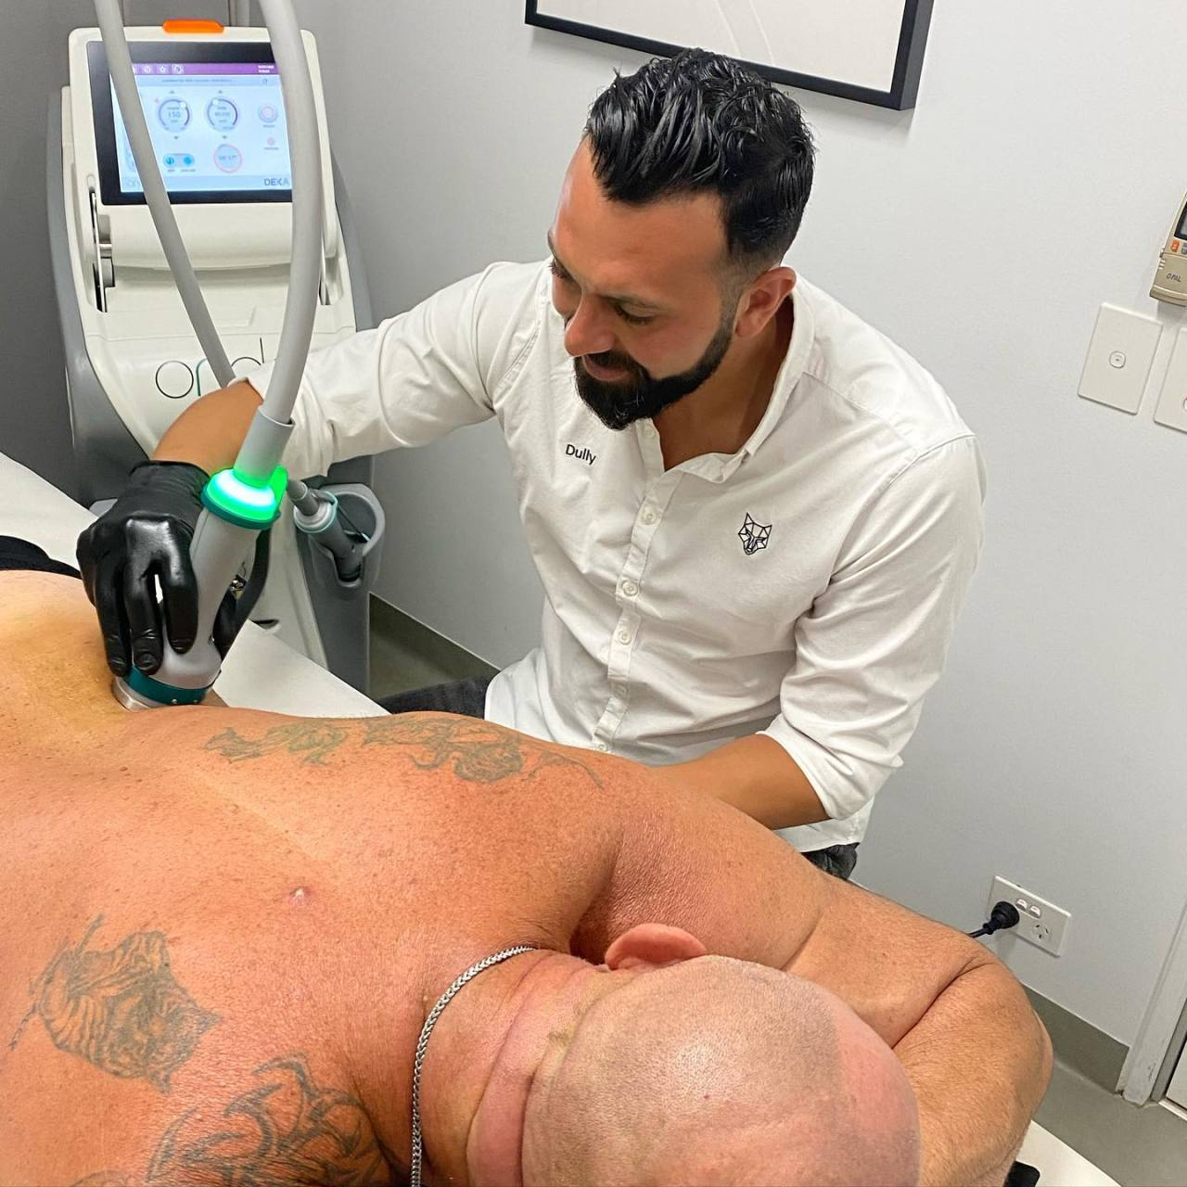
Are You Looking for Men's Laser Hair
Removal Deals in Sydney

Slide 2
It is easy to get confused when trying to find the way to treat laser hair removal, with all the available options in Sydney. When you are looking for Men’s Laser Hair Removal Deals in Sydney, it is always good to know what to look for and to find a clinic that considers your comfort, outcomes, and time.
At Barewolf – Sydney CBD, our menu is tailored for men who want their treatment to produce good results in a male-only, relaxed setting. It guarantees you can take all the steps without fear as you avail of deals that are befitting to you.
What Makes Men's Laser Hair Removal in Sydney Worth Considering
Laser hair removal is not merely about losing hair, but about saving time, avoiding irritation, and being confident in your own skin. This is the reason why more men prefer this option:
Accuracy: It is accurate enough, targeting hair follicles without damaging the surrounding skin.
Lasting effects: Maintenance frequency is lower than with shaving and waxing.
Coziness: Male clinics such as Barewolf ensure a pain-free experience.

Slide 3
How to Find the Right Deals for Men's Laser Hair Removal in Sydney
Offers may be alluring, but one must be aware of what s/he are getting. Look for:
Straightforward pricing: A Bundle that is not veiled in secrets.
Efficient clinic: Therapies performed by certified specialists.
Adaptable classes: Times that fit your schedule.
These aspects help ensure that a deal is not only cheap but also practical and safe during Laser Hair Removal in Sydney.
What to Expect During Your Laser Hair Removal Session
Knowing how to do this, you will feel less anxious, and this will make your session more fruitful:
Consultation: A qualified specialist examines your skin and hair type.
Treatment: Laser technology is the most effective way of treating unwanted hair.
Aftercare: Simple guidance helps your skin recover quickly.
We focus on making every session straightforward and tailored to men's needs.

Slide 4
FAQs About Men's Laser Hair Removal Deals in Sydney
Q- Will laser hair removal be painful?
Most men feel minimal discomfort, often described as a mild warming sensation.
Q- How many sessions are needed
Typically, 6–8 sessions are recommended for lasting results, depending on hair type and the area being treated.
Q- Are the deals genuine?
Reputable clinics like Barewolf offer clear packages with no hidden conditions, ensuring real value.
Final Thoughts
Finding Men's Laser Hair Removal Deals in Sydney doesn't have to be complicated. By focusing on professional clinics with male-friendly environments, clear deals, and experienced staff, you get real results and a comfortable experience. With treatments designed for modern men, Barewolf – Sydney CBD provides an effective solution for Laser Hair Removal in Sydney while offering deals that make the process accessible and stress-free.

Slide 5
For More Details Contact Us :
Name: Barewolf
Address: 128 Castlereagh St, Sydney NSW 2000, Australia
Telephone: 61450385395
Email id: info@barewolf.com.au
Website: https://maps.app.goo.gl/kaqLf9n5Yei5rKDn7

