Slide 1


Quora Web Solution
Website Design and
Development
Company
Web Design & Web Development
Company in Bangalore, India
www.quorawebsolution.com
+91 9986 056 909
info@quorawebsolutions.com
24A, 1st Main Rd, Chandra Reddy
Layout, Koramangala 4th Block,
Koramangala, Bengaluru,
Karnataka 560034

Slide 2

Why Partnering with a Full-Service Website Design and Development Company Is the Smartest Move for Growing Brands
In today’s fiercely competitive digital landscape, having a strong online presence is no longer optional — it’s essential.
www.quorawebsolution.com

Slide 3
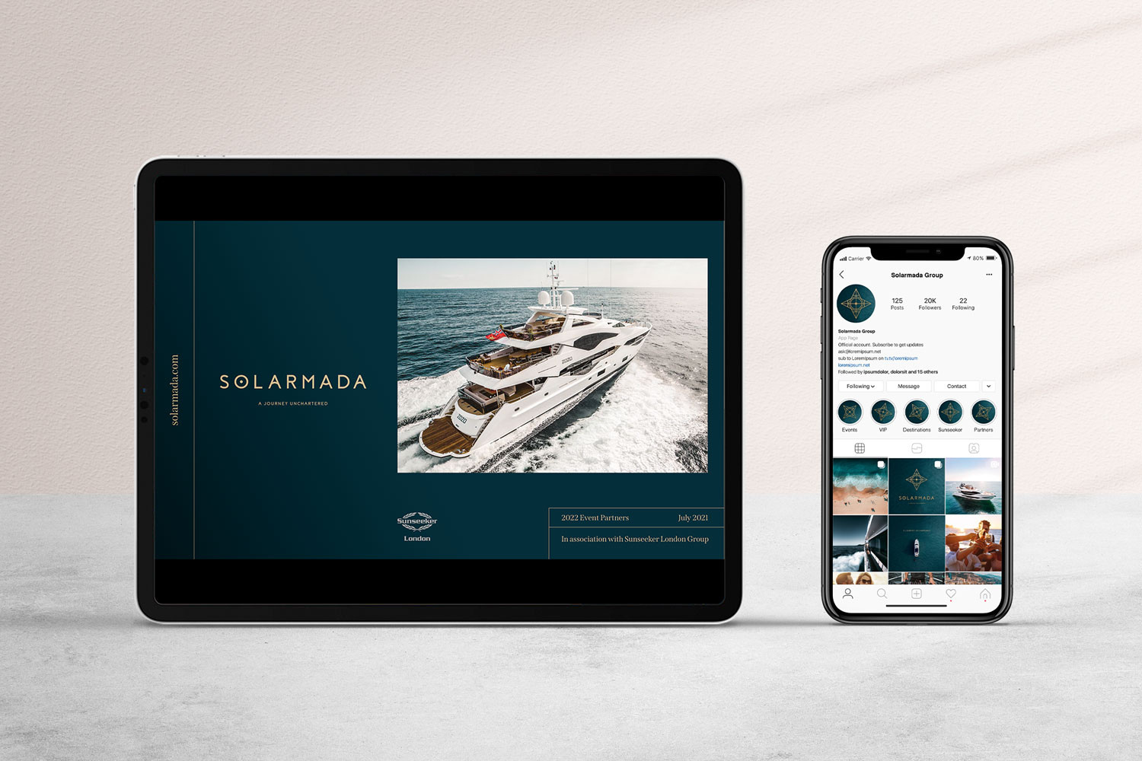
However, building a successful website that not only looks impressive but also functions flawlessly requires more than just a few design tweaks. This is where a full-service website design and development company comes into play. For growing brands, partnering with an experienced and versatile agency can mean the difference between blending in and standing out.
www.quorawebsolution.com

Slide 4
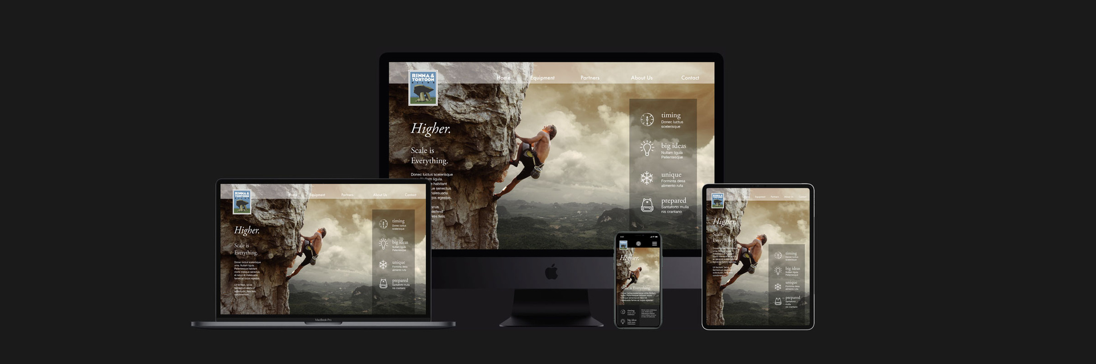
Let’s dive into why choosing a full-service partner is the smartest decision for businesses looking to scale.
1. Comprehensive Expertise Under One Roof
A full-service company offers a wide range of services, from UI/UX design, front-end and back-end development, to SEO optimization, content creation, and even ongoing maintenance.
www.quorawebsolution.com

Slide 5

Instead of juggling multiple vendors for different tasks, you get access to an entire team of specialists who collaborate seamlessly on your project.
This unified approach leads to:
Better communication
www.quorawebsolution.com

Slide 6
Faster project timelines
Higher quality outcomes
Consistent branding across all digital touchpoints
2. Tailored Solutions for Unique Business Needs
No two brands are the same — and a cookie-cutter website won’t cut it. A full-service agency takes the time to understand your business model, target audience, and long-term goals. They create custom strategies and solutions designed specifically for your needs, whether you’re launching an e-commerce store, building a corporate site, or promoting a personal brand.
Tailored services help ensure that your website:
Speaks directly to your ideal customer
www.quorawebsolution.com

Slide 7
Enhances your brand identity
Grows with your business
3. Access to the Latest Technologies and Trends
The digital world evolves rapidly. Strategies and technologies that were effective last year might already be obsolete today. Full-service website design and development companies maintain their edge by consistently embracing the latest technologies, design trends, security standards, and SEO best practices.
By partnering with such a company, your brand benefits from:
Cutting-edge web design
Mobile-first, responsive development
Advanced security features
Integration of emerging tools like AI chatbots, AR/VR, or voice search optimization
www.quorawebsolution.com

Slide 8
4. Focus on Core Business Activities
As your brand grows, your focus should remain on scaling operations, enhancing products or services, and nurturing customer relationships — not troubleshooting website glitches.
By outsourcing your website needs to a trusted full-service partner, you free up your internal resources and ensure that web development doesn't become a bottleneck for your expansion plans.
5. Ongoing Support and Maintenance
Building a website is just the beginning. It requires continuous updates, performance optimization, and security monitoring to keep functioning at peak efficiency. Full-service agencies offer post-launch support packages, ensuring your website stays healthy, loads quickly, and remains protected against cyber threats.
With ongoing support, you benefit from:
www.quorawebsolution.com

Slide 9
Regular software updates
Content refreshes
Real-time issue resolution
Analytics tracking and reporting
6. Stronger Return on Investment (ROI)
When you invest in a full-service company, you're paying for a well-rounded strategy that combines visual appeal, technical excellence, and marketing prowess. This synergy leads to:
Higher user engagement
Lower bounce rates
Increased conversion rates
www.quorawebsolution.com

Slide 10
Better brand loyalty
In the long run, a professionally built and managed website generates significantly higher returns compared to one pieced together from multiple vendors or DIY efforts.
Final Thoughts
For brands determined to grow and thrive in today’s crowded market, a stunning website isn’t a luxury — it’s a necessity. Partnering with a full-service website design and development company ensures that you’re not just building a website; you're building a powerful digital foundation for your future.
With expert guidance, tailored strategies, cutting-edge technologies, and unwavering support, your brand can focus on what it does best — delivering excellence — while your online presence works tirelessly to attract, engage, and convert your audience.
www.quorawebsolution.com

Slide 11
Step-by-Step Breakdown of a Successful Website Design and Development Project Timeline
In today’s fast-paced digital world, having a professionally designed and well-developed website is crucial for any business. But behind every successful website is a well-structured process — a timeline that ensures every phase is planned, executed, and refined carefully. Whether you’re working with a website design and development company or building your own team, understanding the step-by-step breakdown is essential.
Here’s a complete walkthrough of a successful website design and development project timeline:
1. Discovery and Research Phase (1–2 Weeks)
Every great project starts with deep understanding.
Key Activities:
Define project goals and objectives
Identify the target audience and user personas
Conduct competitor analysis and industry research
www.quorawebsolution.com

Slide 12
Gather requirements (features, functionality, technologies, SEO needs)
Deliverables:
Project brief
Research findings
Initial strategy document
Importance:
This stage lays the foundation for the design and development, ensuring the site is tailored to business needs and user expectations.
2. Planning and Strategy (1 Week)
With research in hand, planning the roadmap becomes the focus.
Key Activities:
Create a sitemap outlining all pages and their hierarchy
Develop wireframes (low-fidelity mockups of key pages)
www.quorawebsolution.com

Slide 13
Establish technical requirements (CMS, integrations, hosting needs)
Define content strategy (what content is needed and how it will be created)
Deliverables:
Sitemap
Wireframes
Technical plan
Importance:
Clear planning helps align the entire team and avoid scope creep later.
3. Content Creation and Gathering (2–4 Weeks)
Quality content is what turns visitors into customers.
Key Activities:
Write website copy that’s SEO-optimized
Create media assets (images, videos, graphics)
www.quorawebsolution.com

Slide 14
Collect testimonials, case studies, product descriptions, etc.
Deliverables:
Finalized text content
Visual content library
Importance:
Content should be finalized before or during design to ensure proper layout and user flow.
4. Design Phase (3–4 Weeks)
Now comes the exciting part — bringing ideas to life visually.
Key Activities:
Design homepage and key inner pages
Define color schemes, fonts, and style guidelines
Ensure mobile-responsiveness and UX/UI best practices
Iterate designs based on feedback
www.quorawebsolution.com

Slide 15
Deliverables:
High-fidelity mockups
Style guide
Importance:
A compelling design builds trust, boosts engagement, and sets the tone for the brand’s digital presence.
5. Development Phase (4–6 Weeks)
Time to make the designs functional and interactive.
Key Activities:
Set up CMS or code the website (HTML, CSS, JavaScript, backend development)
Implement all functionalities (contact forms, e-commerce, booking systems, etc.)
Integrate third-party services (CRM, analytics, payment gateways)
Deliverables:
Fully functional website prototype
www.quorawebsolution.com

Slide 16
Staging environment for testing
Importance:
Clean, efficient coding ensures speed, security, and future scalability.
6. Testing and Review (2 Weeks)
Before launch, thorough testing is non-negotiable.
Key Activities:
Cross-browser and device compatibility testing
Speed and performance optimization
SEO audits (meta tags, image optimization, URL structure)
User experience testing
Bug fixing and quality assurance (QA)
Deliverables:
Test reports
www.quorawebsolution.com

Slide 17
Final revisions list
Importance:
Testing ensures a smooth, professional user experience and prevents post-launch issues.
7. Launch (1–3 Days)
The big moment has arrived.
Key Activities:
Migrate site from staging to live server
Final checklist validation (SEO, performance, integrations)
Set up analytics and tracking tools
Announce launch (email marketing, social media, press release)
Deliverables:
Live website
Launch report
www.quorawebsolution.com

Slide 18
Importance:
A well-coordinated launch ensures minimal downtime and maximum impact.
8. Post-Launch Maintenance and Optimization (Ongoing)
A website is never truly "finished."
Key Activities:
Monitor site performance and uptime
Regular backups and updates
SEO monitoring and adjustments
Content updates and enhancements
Analyze visitor behavior for continuous improvements
Deliverables:
Monthly maintenance reports
www.quorawebsolution.com

Slide 19
Ongoing SEO and performance reports
Importance:
Ongoing support ensures your website continues to grow and evolve with your business and technology trends.
Conclusion
A successful website design and development project isn't a race — it's a carefully planned journey. By following a structured timeline and focusing on each critical phase, you can create a powerful digital presence that drives traffic, engages users, and achieves business goals.
Partnering with an experienced website design and development company can make this process smoother, faster, and more effective, ensuring your brand stands out in the crowded digital marketplace.
www.quorawebsolution.com

Slide 20
Quora Web Solution: Quora Web Solution is a trusted website development company based in Bangalore, India, offering a wide array of services to not only domestic but global clientele. Be it Website Design and Development, SEO services, Digital Marketing, Branding, App Development, Ecommerce Solution, and Logo Creation . Quora Web Solution has the best website developers offering top quality services and that is the reason why we are well known as one of the best Website Development Companies in Bangalore, India.
Visit Us - www.quorawebsolution.com
Call Us - +91 9986 056 909
Mail Us - info@quorawebsolutions.com
www.quorawebsolution.com

Slide 21

WORDPRESS DEVELOPMENT
ECOMMERCE DEVELOPMENT
PHP DEVELOPMENT
CMS DEVELOPMENT
DRUPAL DEVELOPMENT
WEBSITE SERVICES
WEBPORTAL DEVELOPMENT
MAGENTO DEVELOPMENT
WEBSITE DEVELOPMENT
JOOMLA DEVELOPMENT
SMALL BUSINESS DEVELOPMENT
CHEAP WEBSITE DEVELOPMENT
STATIC WEBSITE DEVELOPMENT
DYNAMIC WEBSITE DEVELOPMENT
WEBSITE DESIGN COMPANY
TOUR AND TRAVEL WEBSITE DEVELOPMENT
Services

