Slide 1

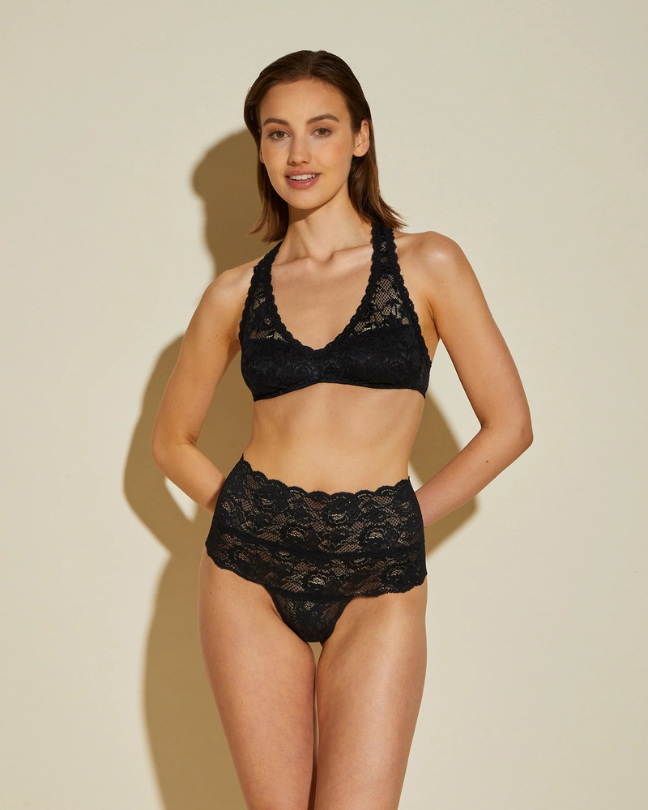
Lingerie Black Bodysuit
Choose our lingerie black bodysuit for a flattering fit and soft, stretchy lace fabric that offers support and grace, best for feeling sexy & confident anytime.

Slide 2
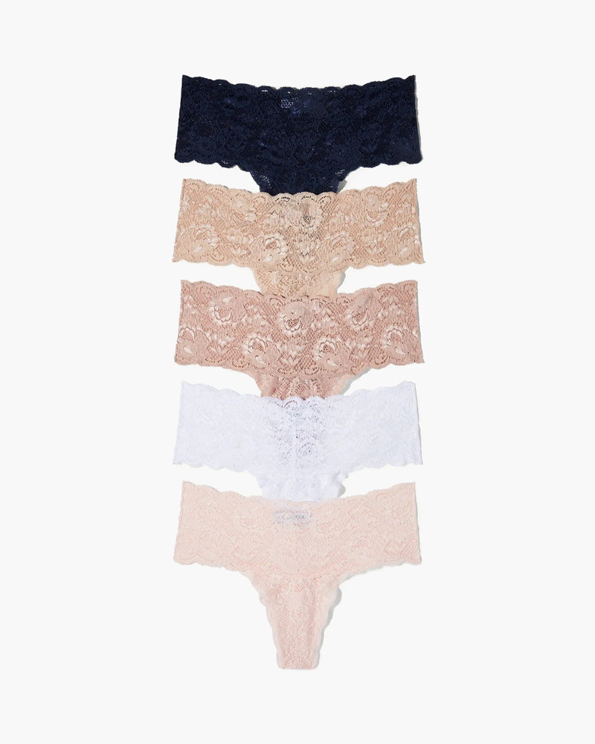
High Waisted Panties
Unlock confidence with our high waisted panties, designed to offer tummy control and a vintage-inspired fit that is both flattering and comfortable all day.

Slide 3
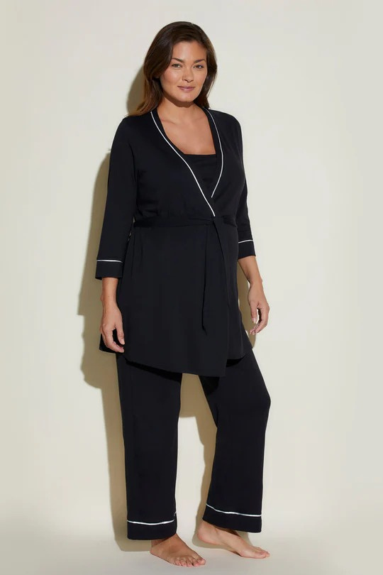
Lounging Robes
Explore our lounging robes made with soft, breathable fabric that wraps you in warmth and comfort, perfect for relaxing at home or unwinding after a long day.

Slide 4

Contact Us
Cosabella creates luxurious Italian lingerie, bras, panties, & sleepwear with exceptional craftsmanship, with inclusive sizing, free returns, and expert fitting, feel comfortable, confident, & beautiful.
Address :-
12186 SW 128th Street, Miami
Website :-
https://www.cosabella.com/

