Slide 1


Quora Web Solution
Website Design and
Development
Company
Web Design & Web Development
Company in Bangalore, India
www.quorawebsolution.com
+91 9986 056 909
info@quorawebsolutions.com
24A, 1st Main Rd, Chandra Reddy
Layout, Koramangala 4th Block,
Koramangala, Bengaluru,
Karnataka 560034

Slide 2

The Complete Guide to Choosing the Right Website Design and Development Company for Your Brand's Digital Presence
In today’s fast-paced digital world, your website is more than just a digital address—it's your brand's most powerful marketing tool.
www.quorawebsolution.com

Slide 3

Whether you're launching a new venture or revamping an existing site, selecting the right website design and development company is crucial for long-term success. This comprehensive guide walks you through everything you need to know to make the best decision for your brand’s online presence.
1. Understand Your Business Needs and Goals
www.quorawebsolution.com

Slide 4

Before reaching out to any web development agency, clearly define:
What is the primary goal of your website (lead generation, e-commerce, portfolio, information, etc.)?
Who is your target audience?
What functionalities are essential (e.g., contact forms, booking systems, payment gateways)?
www.quorawebsolution.com

Slide 5
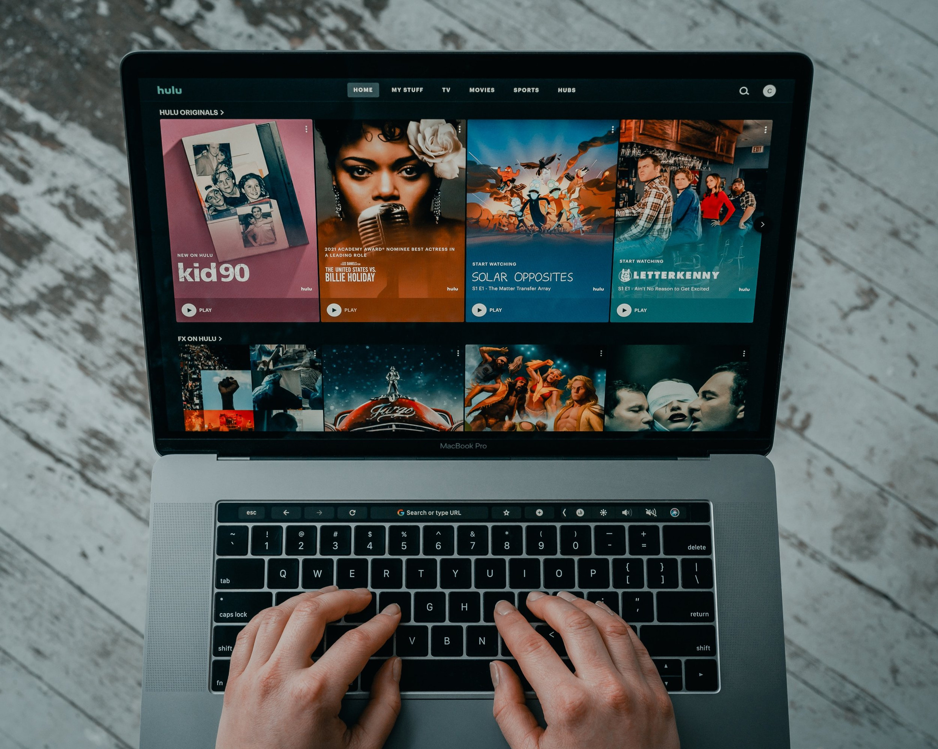
Do you require ongoing support, SEO, or digital marketing services?
Having clarity helps you communicate effectively and choose a company that aligns with your vision.
2. Look for Relevant Industry Experience
Experience in your industry can be a huge advantage. A company familiar with your market will:
www.quorawebsolution.com

Slide 6
Understand your audience’s behavior
Know common challenges
Deliver features tailored to your sector
Ask for case studies or portfolios that show experience in your niche, such as healthcare, education, e-commerce, or real estate.
3. Evaluate Their Portfolio and Design Aesthetics
Review the company’s previous work to assess:
Design style and creativity
User experience (UX) and responsiveness
Variety in functionality and layout
www.quorawebsolution.com

Slide 7
If every site looks the same, they may not customize designs. Look for uniqueness and consistency with brand identity in their portfolio.
4. Assess Technical Capabilities
A top-tier website development company should offer expertise in:
Front-end and back-end technologies (e.g., HTML5, CSS3, JavaScript, PHP, Python)
CMS platforms (WordPress, Shopify, Drupal, Magento)
Mobile responsiveness and cross-browser compatibility
Website performance optimization and security
Ask which technologies they recommend and why. Their answers will show their depth of knowledge.
5. Inquire About SEO and Digital Strategy
www.quorawebsolution.com

Slide 8
A beautiful website is meaningless without traffic. Make sure your chosen company:
Understands on-page SEO (meta tags, site structure, speed optimization)
Implements technical SEO practices
Offers content strategy and marketing services
A holistic agency will help you attract, engage, and convert visitors—not just launch a site.
6. Discuss Communication and Project Management
Effective communication ensures smooth collaboration. Ask about:
Project timelines and milestones
Collaboration tools (Slack, Trello, Asana)
Point of contact and reporting frequency
www.quorawebsolution.com

Slide 9
Choose a company that values transparency, responds promptly, and is open to feedback throughout the process.
7. Compare Pricing Models and Contracts
Website development costs vary depending on features, design complexity, and customizations. Understand:
Fixed vs hourly pricing
What’s included in the proposal (hosting, maintenance, updates)
Payment structure and contract terms
Don’t choose the cheapest option—invest in value, not just price.
8. Ask About Maintenance and Support Services
Websites require ongoing updates, backups, and security patches. Ask whether they offer:
www.quorawebsolution.com

Slide 10
Monthly or annual maintenance plans
Bug fixing and performance monitoring
Website backups and recovery services
This ensures your site stays secure, functional, and optimized long after launch.
9. Read Reviews and Request References
Check Google, Clutch, Upwork, or other review platforms for unbiased feedback. Additionally:
Request client references
Ask about their satisfaction, challenges, and final outcomes
Hearing directly from previous clients gives valuable insight into what working with the company is really like.
10. Ensure Scalability and Future Readiness
www.quorawebsolution.com

Slide 11
Your website should grow with your business. Make sure the agency:
Builds scalable and modular code
Provides documentation and training (especially if you’re using a CMS)
Designs with flexibility for future features
A future-ready website saves you from costly redesigns.
Conclusion
Choosing the right website design and development company can make or break your online success. By considering experience, design quality, technical skills, communication, and ongoing support, you’ll be well-equipped to find a partner that truly elevates your digital presence. Invest wisely—not just in a website, but in a long-term digital foundation for your brand.
Why Every Business Needs a Custom Website in 2025: Insights from Leading Web Design Agencies
www.quorawebsolution.com

Slide 12
In 2025, a digital presence is no longer optional—it's the core of any business’s marketing, branding, and customer experience strategy. With online competition intensifying across every industry, businesses must go beyond basic templates or cookie-cutter solutions. The demand for custom websites has surged, and leading web design agencies agree: a tailored digital experience can define whether your business thrives or gets lost in the noise.
In this article, we explore the top reasons why a custom website is essential for businesses in 2025, with insights from experienced web design professionals.
1. Template Sites Are Obsolete in Competitive Markets
Generic website builders like Wix or Squarespace are fast and easy, but they come with major limitations—especially in scalability, performance, and brand identity.
“Templates restrict creativity and SEO flexibility,” says Riya Sharma, UX strategist at Delhi-based PixelForge Studio. “In 2025, users expect a unique experience, and templates just can’t deliver that.”
www.quorawebsolution.com

Slide 13
Custom websites are designed from the ground up to reflect your brand’s identity, communicate your value proposition clearly, and stand out from competitors.
2. Custom Web Design Drives Better User Experience (UX)
Modern customers judge a business within seconds of visiting their website. Navigation, loading speed, layout, and mobile responsiveness all impact a visitor’s perception—and their likelihood to convert.
“Every business has different user needs. A bakery’s customers don’t interact the same way as an IT firm’s clients,” says Jordan Liu, Lead Developer at CloudRoot Agency. “A custom UX approach guarantees that the website is easy to navigate and specifically designed to meet the unique behaviors and expectations of its target audience.”
Custom websites allow for data-driven UX design, ensuring that every interaction is optimized for engagement and conversion.
3. Enhanced SEO and Performance Optimization
www.quorawebsolution.com

Slide 14
In 2025, Google's algorithm continues to prioritize speed, mobile usability, and structured data. Template-based websites are frequently burdened with excessive, non-optimized code and lack the advanced SEO capabilities needed for high search engine performance. A custom-built site can be optimized at the code level for lightning-fast performance and top-tier search visibility.
“You simply can't compete for organic search rankings with a drag-and-drop builder,” warns SEO expert Anjali Mehta. “Custom websites allow us to implement technical SEO properly—from schema markup to server-side rendering.”
4. Scalability for the Future
A business may start small, but growth means new needs—advanced eCommerce, CRM integrations, membership areas, APIs, or multilingual support. With a custom development approach, your website grows alongside your business.
www.quorawebsolution.com

Slide 15
“When you build custom, you’re building a foundation for the long term,” explains Mark Rivera, CTO at NexaCraft Studios. “You can integrate new technologies without having to rebuild the site from scratch.”
5. Security and Compliance
Cyber threats are evolving, and in 2025, data privacy laws like GDPR, CCPA, and India's DPDP Act require businesses to be more proactive than ever. Custom websites allow developers to implement robust security protocols and ensure compliance with regional laws.
“Pre-built platforms can’t always provide the level of control businesses need for compliance,” notes Priya Deshmukh, Legal Tech Advisor. “With custom development, businesses retain full control over how their data is stored, handled, and safeguarded—allowing for tighter security measures and compliance with evolving regulations.”
6. Brand Credibility and Trust
When a customer lands on your site, it must immediately convey trust and professionalism. A custom design ensures that your visual branding, messaging, and tone align perfectly across all devices.
www.quorawebsolution.com

Slide 16
“The design speaks before the words do,” says UI designer Tomas Becker. “Your website serves as your brand's first impression—it should feel professional, trustworthy, and leave a lasting impact.”
In a world saturated with visual content, a strong, custom digital presence builds credibility and fosters customer loyalty.
Conclusion: Invest in Your Digital Future
In 2025, businesses that want to lead—rather than follow—are investing in custom-built websites. With benefits ranging from SEO performance to user engagement, the ROI of a custom website far outweighs the upfront cost.
If you’re serious about growing your business, it’s time to move beyond templates. Partnering with a professional website design and development company ensures you’re not just keeping up with the digital age—you’re leading it.
www.quorawebsolution.com

Slide 17
Quora Web Solution: Quora Web Solution is a trusted website development company based in Bangalore, India, offering a wide array of services to not only domestic but global clientele. Be it Website Design and Development, SEO services, Digital Marketing, Branding, App Development, Ecommerce Solution, and Logo Creation . Quora Web Solution has the best website developers offering top quality services and that is the reason why we are well known as one of the best Website Development Companies in Bangalore, India.
Visit Us - www.quorawebsolution.com
Call Us - +91 9986 056 909
Mail Us - info@quorawebsolutions.com
www.quorawebsolution.com

Slide 18

WORDPRESS DEVELOPMENT
ECOMMERCE DEVELOPMENT
PHP DEVELOPMENT
CMS DEVELOPMENT
DRUPAL DEVELOPMENT
WEBSITE SERVICES
WEBPORTAL DEVELOPMENT
MAGENTO DEVELOPMENT
WEBSITE DEVELOPMENT
JOOMLA DEVELOPMENT
SMALL BUSINESS DEVELOPMENT
CHEAP WEBSITE DEVELOPMENT
STATIC WEBSITE DEVELOPMENT
DYNAMIC WEBSITE DEVELOPMENT
WEBSITE DESIGN COMPANY
TOUR AND TRAVEL WEBSITE DEVELOPMENT
Services

