Slide 1


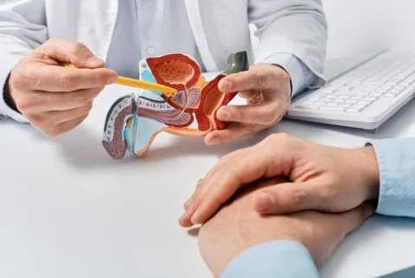

Peyronie’s Disease Treatment Tucker
Find lasting relief with Peyronie’s disease treatment in Tucker. Advanced, safe solutions designed to improve penile curvature, comfort & confidence naturally.

Slide 2


Non-Drug ED Treatment
Restore sexual performance safely with non-drug ED treatment. New, drug-free therapies help improve erections, boost confidence & support lasting results.

Slide 3


Regenerative Cell Therapy
Enhance healing & sexual health with regenerative cell therapy. Cutting-edge treatments target tissue repair to support improved function & long-term wellness.

Slide 4


Contact Us
About: Georgia Male Performance Clinic provides advanced, non-surgical men’s health treatments in Duluth, specializing in ED solutions, hormone therapy, GAINSWave®, & personalized care to restore confidence.
Address: 3635 Peachtree Industrial Blvd Suite 600 Duluth, GA 30096, Georgia, United States
Website: https://www.georgiamaleperformance.com/

