Slide 1
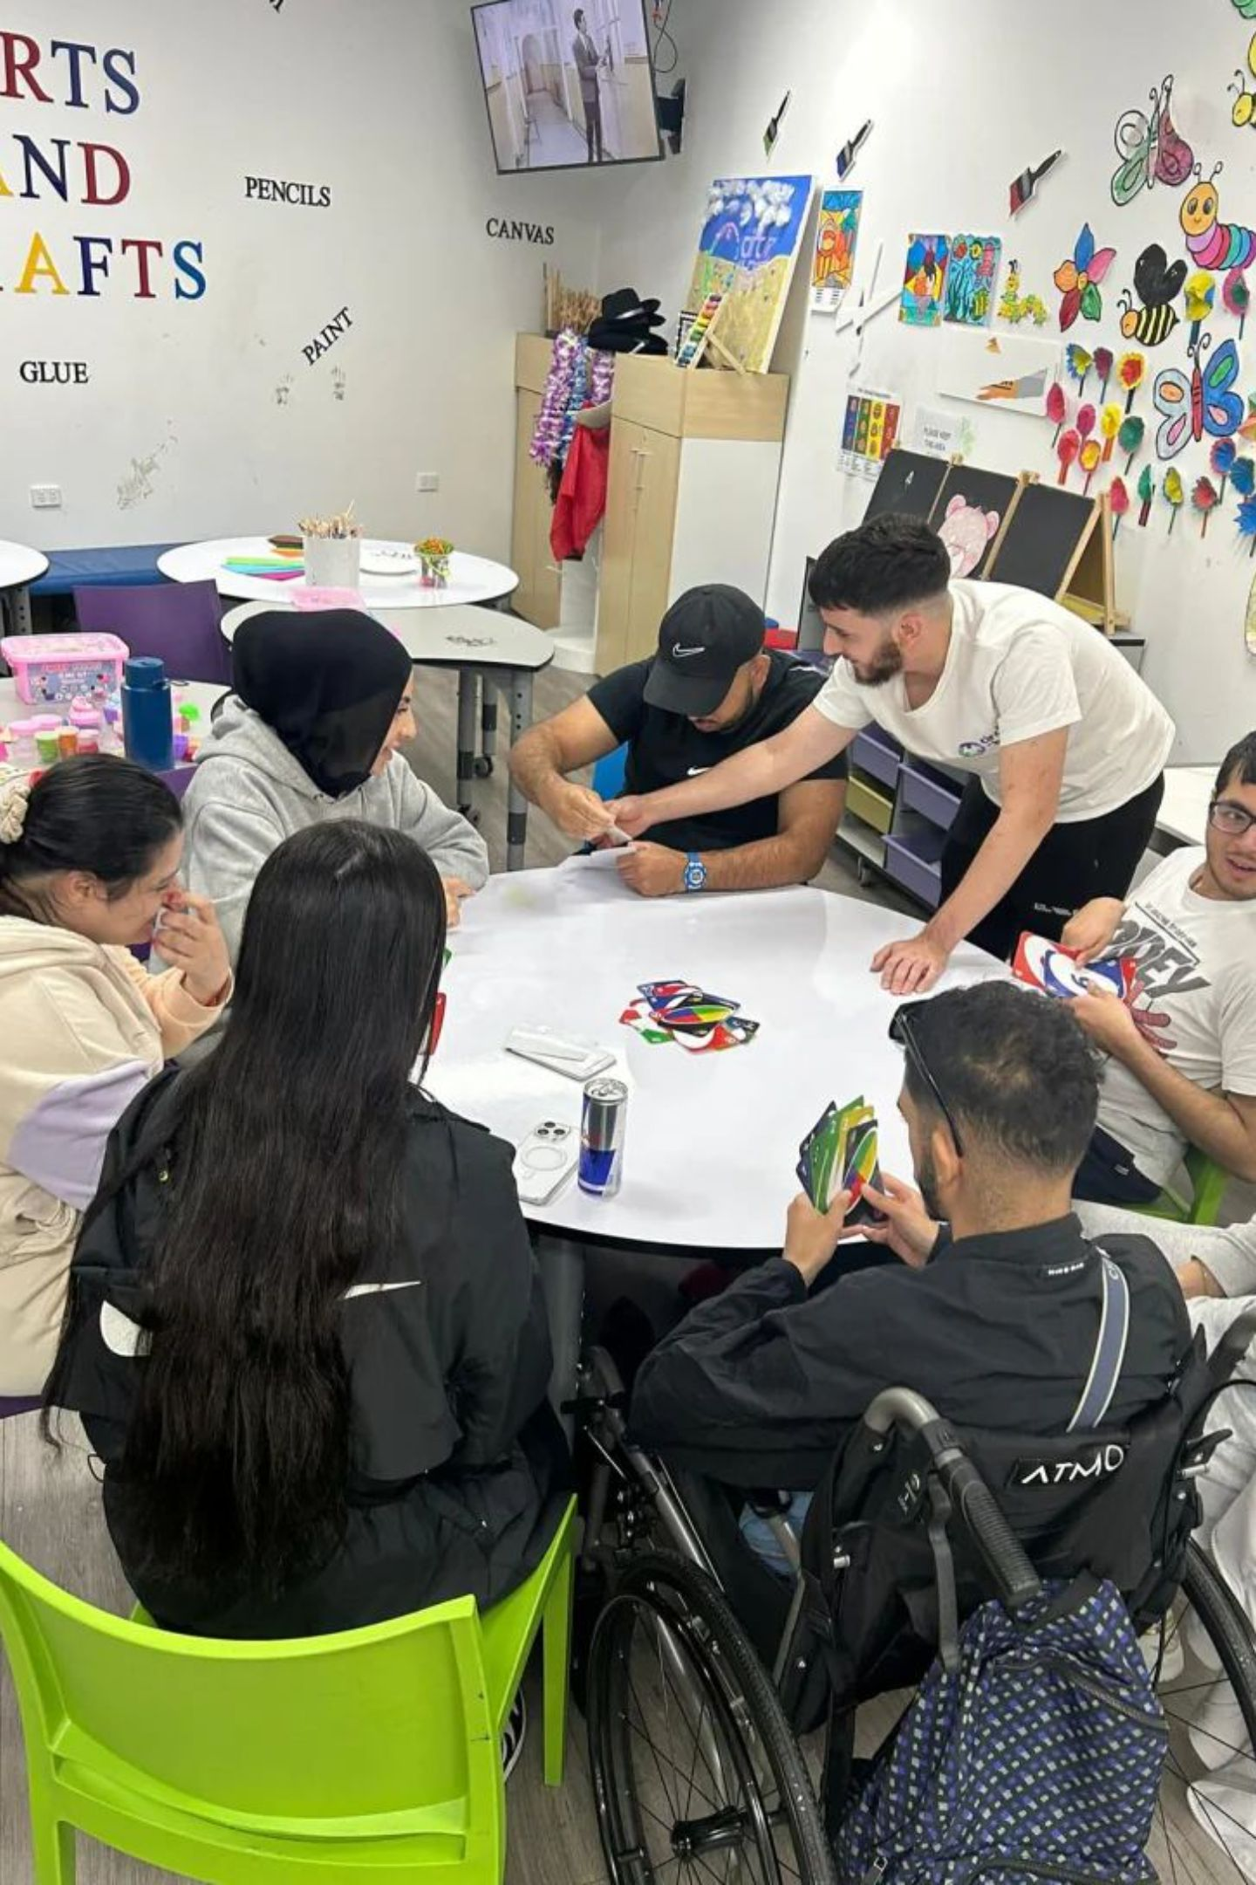
NDIS Disability Support in Carramar: Services Explained
The NDIS helps with everyday activities, learning, getting around, and staying connected. Whether you're new to the NDIS or switching providers, understanding your options helps you make the most of your plan.

Slide 2

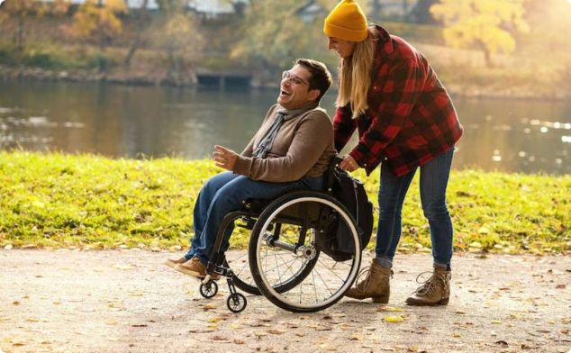
What Does NDIS Support Really Look Like?
There's no fixed template — support is tailored to your goals. The best NDIS providers in Carramar create a custom package after assessing your needs.
Everyday Living
Community & Social
Building Skills
Personal care, meal prep, cleaning, laundry, and help with errands — arranged as often as you need.
Attend local events, join clubs, take classes, or volunteer — staying connected keeps life interesting.
Communication, budgeting, cooking, navigating transport, decision-making, and job readiness — all aimed at greater independence.

Slide 3
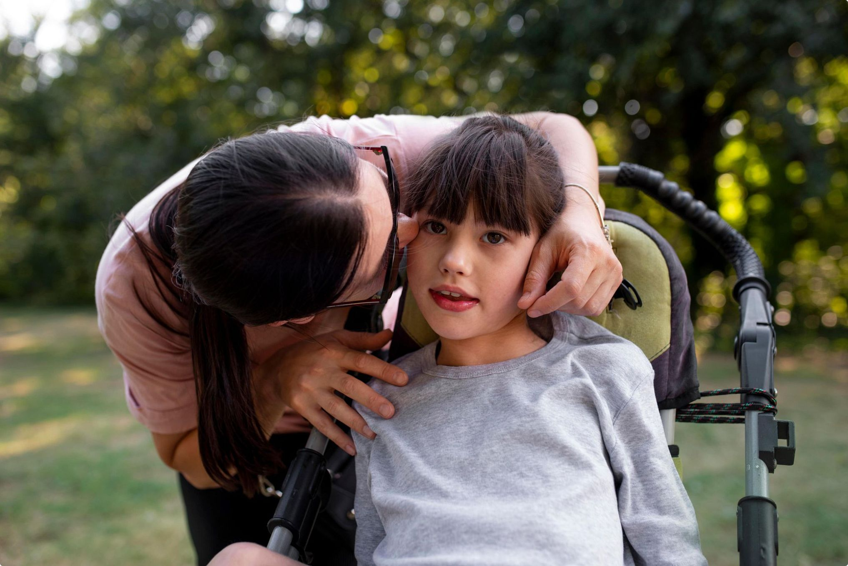

HEALTH & LIVING
Therapy, Health & Supported Living
Therapy & Allied Health
Physiotherapy, occupational therapy, speech pathology, and mental health support from a psychologist — choose what fits your needs.
Supported Independent Living (SIL)
For those needing around-the-clock support, SIL helps whether you live alone or share accommodation — tailored to your situation.

Slide 4

Choosing the Right Provider
Finding the right NDIS provider in Carramar is a crucial decision. Here's what matters most:
Check Their Track Record
Quality of Caregivers
Review their past performance and reputation in the community.
The most important factor — skilled, compassionate staff who understand your needs.
Personalised Planning
The best agencies design a plan that truly meets your expectations and goals.

